Slide 1

INSARAG
International Search & Rescue Advisory Group
Team Leaders Meeting
​
6-7 July 2026
Foz do Iguaçu, Brazil

Slide 2
1
Session 1:
Opening Remarks & Group Photo
Notes:
Letter 2 of 3 From Emily to WG co-chairs/Chairs

Slide 3
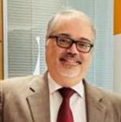
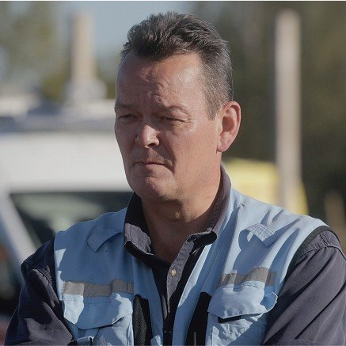
Opening Remarks
Min. José Solla
Coordinator General of Humanitarian Cooperation, Brazilian Cooperation Agency (ABC)
Ministry of Foreign Affairs
Mr. Sebastian ​Rhodes Stampa​​
INSARAG Secretary and Chief Emergency Response Section OCHA
Notes:
5 min each speaker (2x5 min)

Slide 4

Introduction of Participants

Slide 5
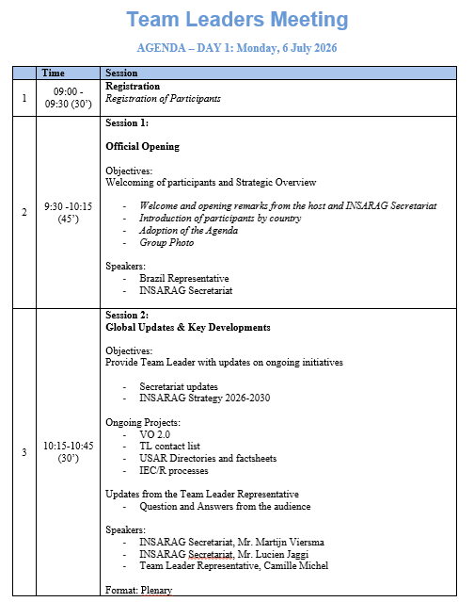
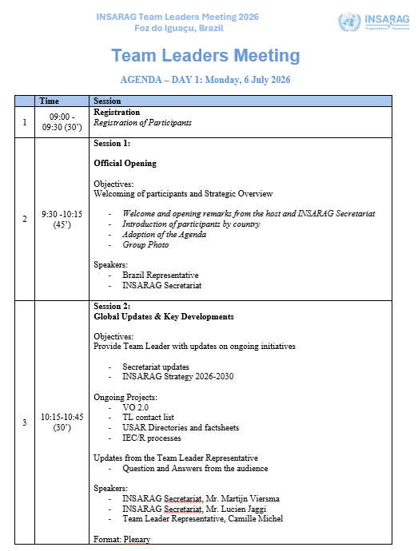
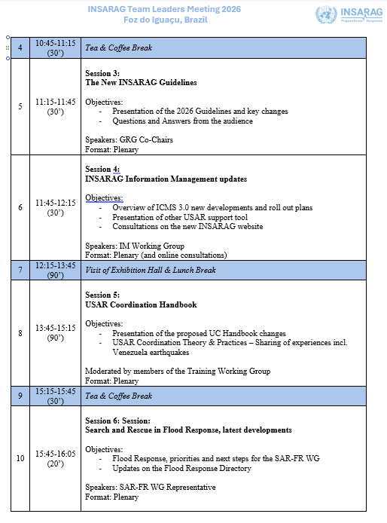
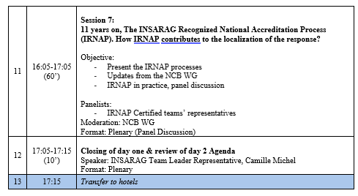

Adoption of the Agenda
DAY 1
Notes:
Highlight the rich content, and group discussions and stress the importance of having participants’ engagement, healthy discussions. It is the TL meeting, “YOUR” meeting and we want to hear from everyone.

Slide 6
GROUP PHOTO

Slide 7
2
Session 2:
Global Updates & Key Developments
Notes:
Letter 2 of 3 From Emily to WG co-chairs/Chairs

Slide 8
Secretariat Updates
Notes:
TO BE UPDATED

Slide 9


INSARAG Strategy 2026-2030
«Our Vision is to save lives by promoting efficiency, enhanced quality and coordination amongst national and international Urban Search and Rescue (USAR) teams based on adherence to common guidelines and methodologies.»
Notes:
Note that the new Strategy was endorsed at the ISG and available on the INSARAG.org
Largely similar to the previous Strategy but the element of Partnership was remove as it was felt that Partnership in inherent to INSARAG and not a specific objective as such. This means the new Strategy focuses now on the 3 pillars of:

Slide 10
Strategy 2026-2030
Strategic Objective 1: Quality Standards
Review and enhance the Guidelines
Promote INSARAG External Classification (IEC) and Reclassification (IER)
Ensure quality of IEC/R
Adoption and localization of INSARAG coordination methodology and concepts to country contexts.
Strategic Objective 2: Flexible Response
develop flexible operational models beyond traditional USAR response
Strategic Objective 3: Strengthening Localization
support tailored regional groups to ensure that INSARAG’s approaches, tools, and coordination mechanisms are adapted to regional languages, cultures, and operational contexts
Implementation of national accreditation systems

Slide 11
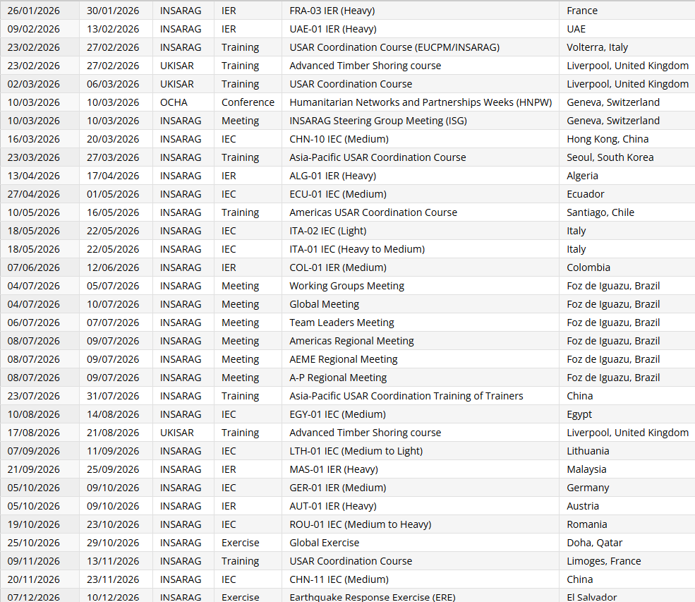
2026 – Programme of Work
177 Classifiers
9 IECs* - 6 IERs - 8 Trainings - 2 Exercises
And 7+ Meetings
22%
78%
6%
23%
94%
77%
^{* 3 are changes in capacity}
Notes:
7 + meeting means that had 7 large meeting but also support the WG meetings, and other many bilateral meeting and activities.
Could add a point on the workload and the need for the Secretariat to (re)empower the network so that we support and not lead on those meetings.

Slide 12
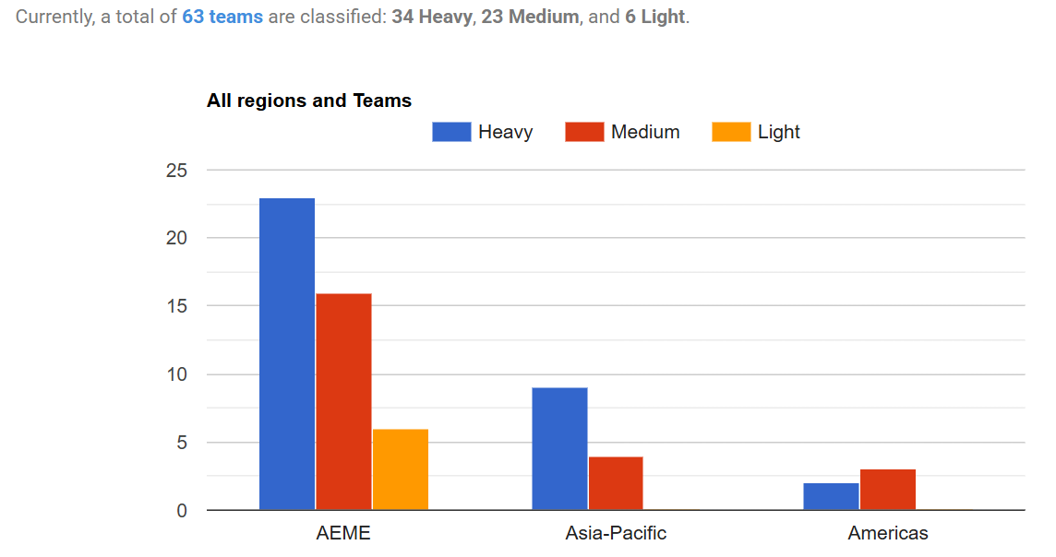
INSARAG Teams
Notes:
Mention the current status and note that there will be a sessions (the last one on day 2) to discuss recommendations to improve/smooth the IEC/R process to ensure we are well equipped to continue supporting the IEC/R.
Also, note that as per the Strategy, the IRNAP is a good alternative and we encourage countries to look into IRNAP before potential IEC/R and that there will be a session today to discuss the IRNAP more in details .

Slide 13
Ongoing Projects
Notes:
TO BE UPDATED

Slide 14
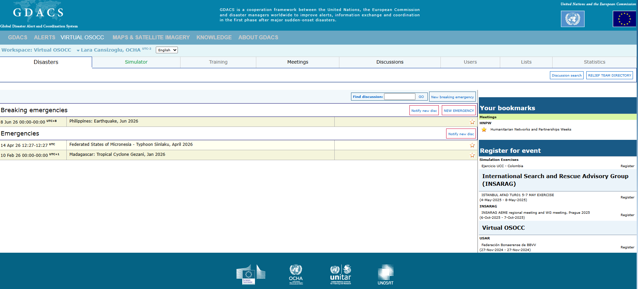
Virtual OSOCC 2.0
Notes:
New platform will be needed, discussing with key partners, the INSARG network will be invited to contribute to redefine the requirements.

Slide 15
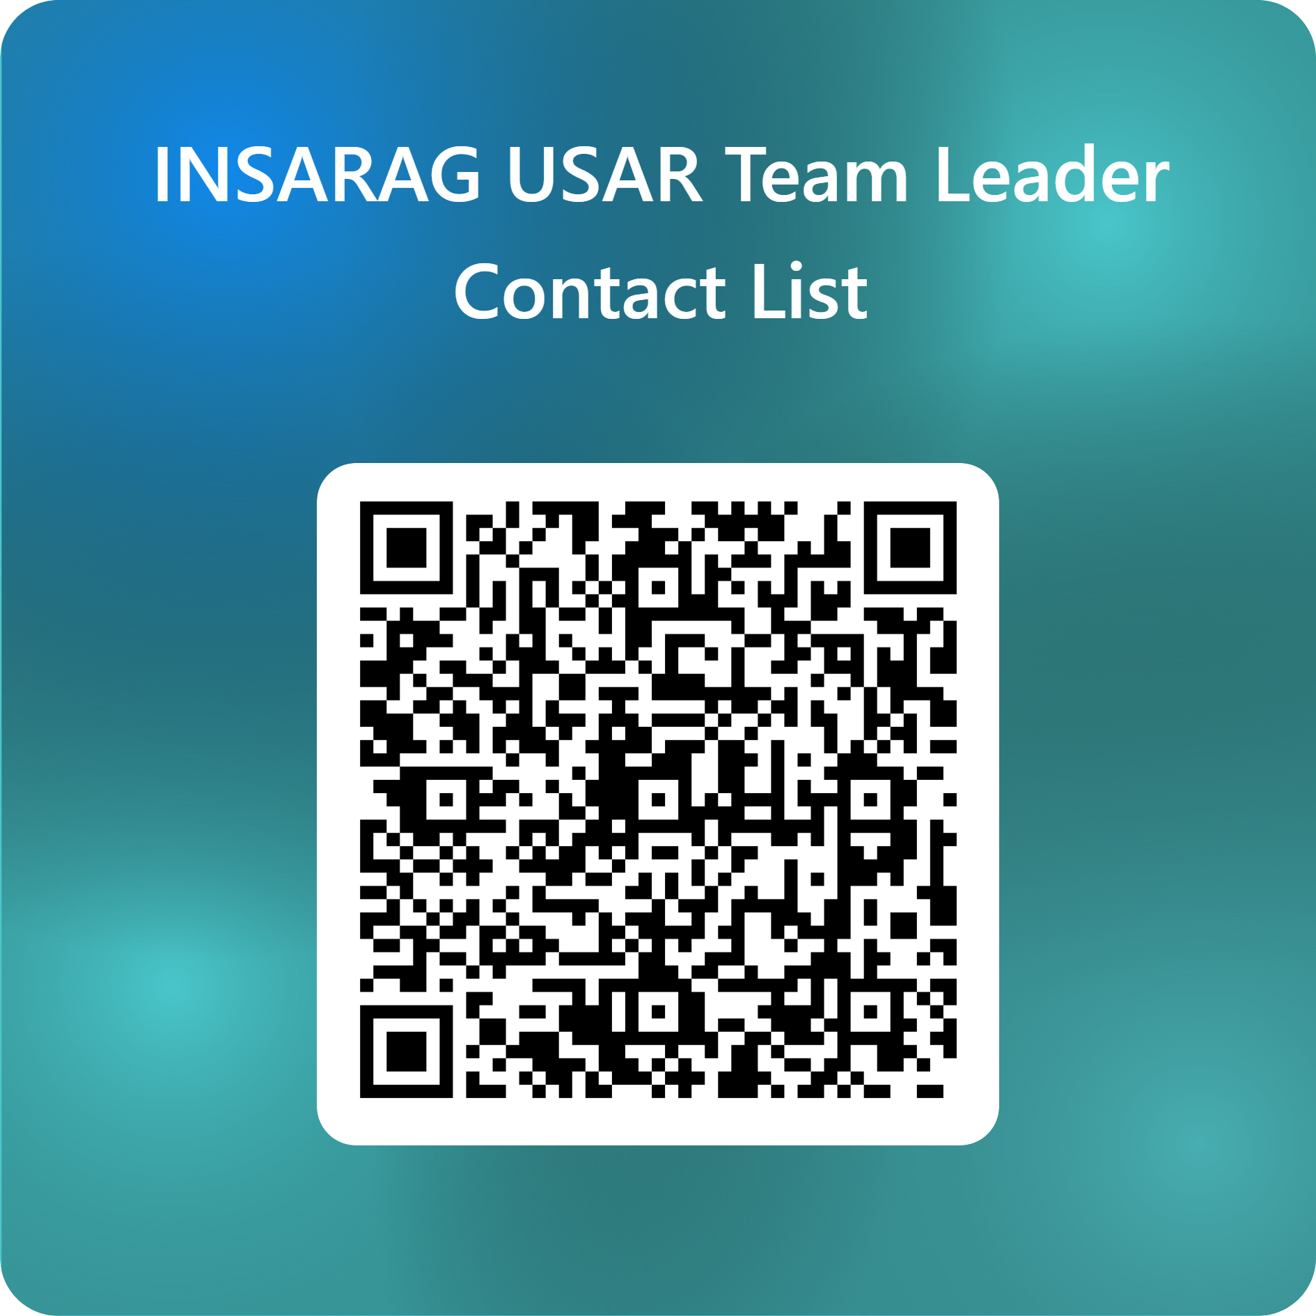
Notes:
- The current list of Team Leaders is of 161 as of today and we have added about 50 in the last month following a request to update.
It is important that all your team members are joining.
This doesn’t have to be done now but it is important to keep contacts updates.

Slide 16
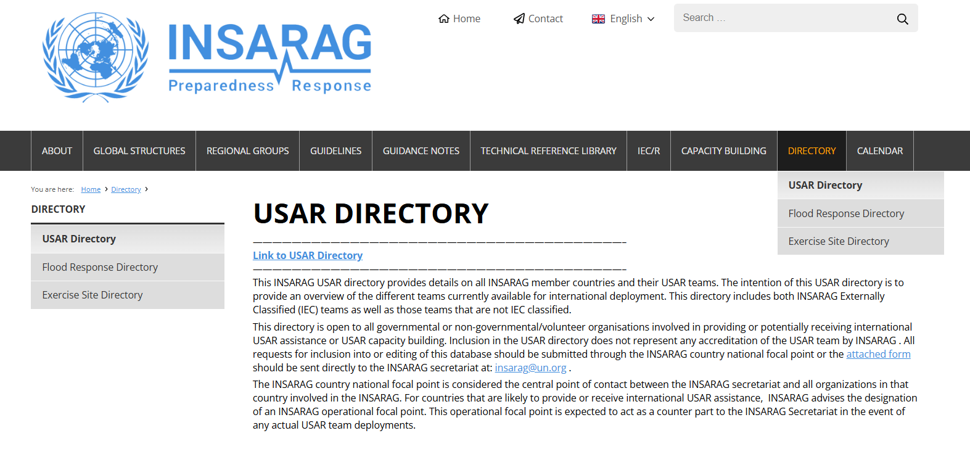
USAR Directories and Factsheets
Notes:
-

Slide 17
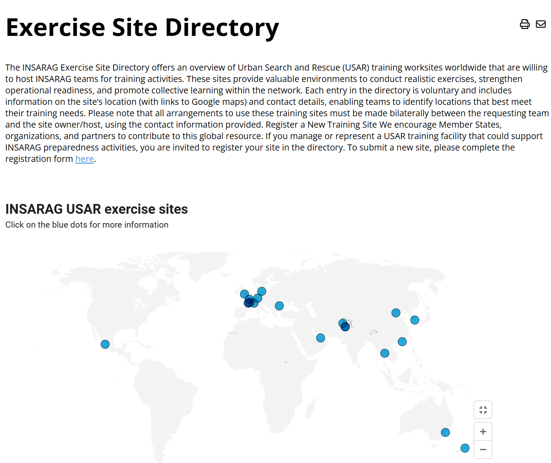
USAR Exercise Sites Map

Slide 18
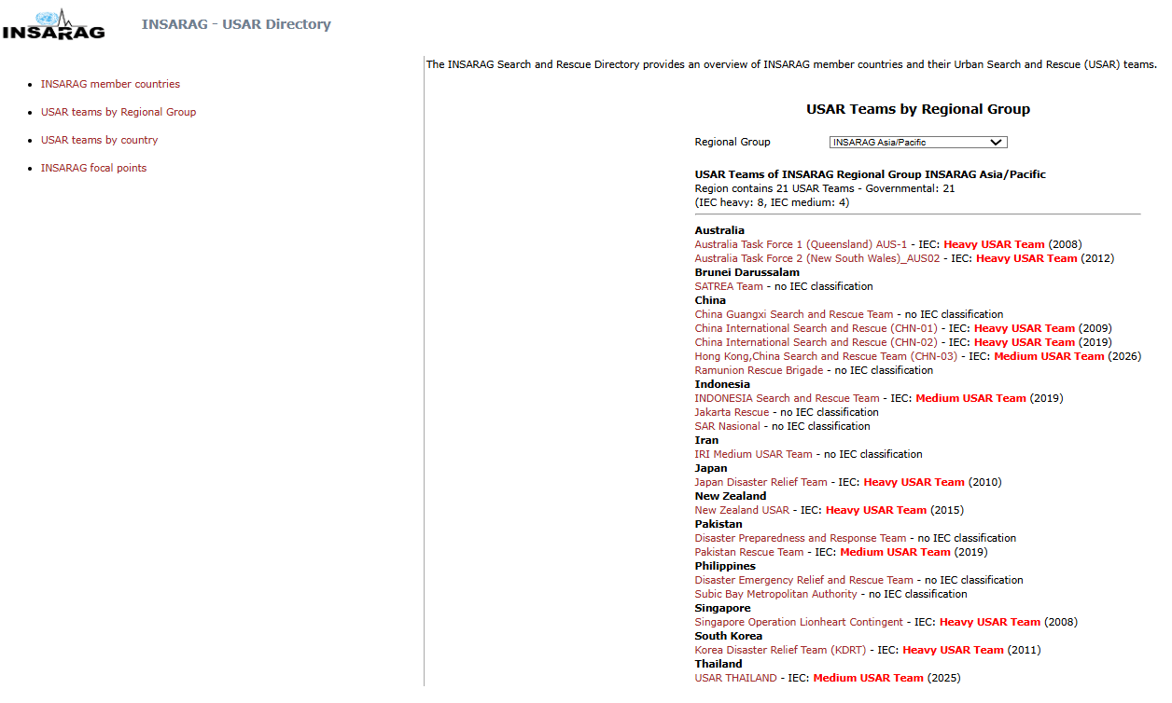
USAR Teams Factsheets
Notes:
Highlight that the information on teams are in the directory, some have not been updated from more than 10 years…

Slide 19
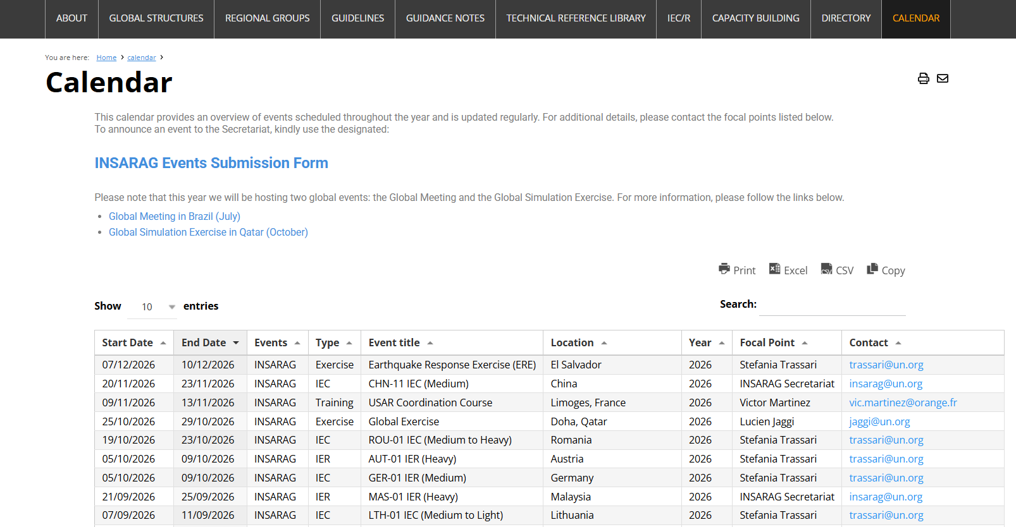
Training Calendar – Event Submission Form

Slide 20
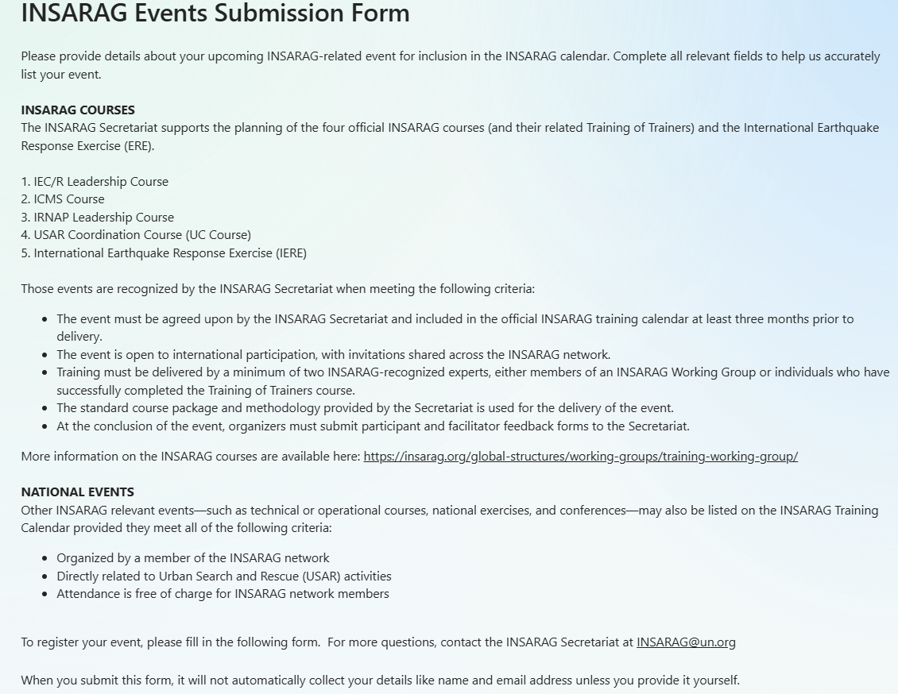
Registering Events with the INSARAG Secretariat

Slide 21
Updates from Team Leader Representative

Slide 22
Observations:
Rely on Secretariat & Working Groups
No up-to-date list (e.g. Team Factsheet)
Planning TL-meeting
Notes:
Many meetings: Global meeting, ISG, Regional Meetings
Focus of Team Leaders should be on a more operational perspective
Team Leaders are most of the time in a consuming mode;
Team Leaders should take more responsibility

Slide 23
Recommendations:
Digital Meeting
Online Training (TL, Class.)
Skilled WG members
Notes:
Many meetings: Global meeting, ISG, Regional Meetings
Focus of Team Leaders should be on a more operational perspective
Team Leaders are most of the time in a consuming mode;
Team Leaders should take more responsibility

Slide 24
Q&A

Slide 25
COFFEE BREAK - 30’

Slide 26
3
Session 3:
The New INSARAG Guidelines

Slide 27
Guideline Review Group
The INSARAG Guidelines are reviewed every 5-years to facilitate continuous improvement.
Due to the large number of recommendations from the Türkiye/Syria AAR and the INSARAG Governance Review an extension of 12 months was approved by the ISG (2025-2026).
The GRG has 12 members represented by all regions, including two NGOs.
The 2026 revision of the INSARAG Guidelines has been developed in accordance with the direction set and decisions made by the Team Leaders Meeting(TLM) and the INSARAG Steering Group (ISG).
The 2026 Guidelines were APPROVED at the 2026 ISG.

Slide 28
2026 Guidelines revision
Strategic Agenda
Team Leaders Meeting
INSARAG Steering Group
Reviews
Governance Review
Turkiye / Syria After Action review
Technical - Working Groups
Training Working Group
Medical Working Group
Information Management Working Group
National Capacity Building Working Group
Quality Assurance – IEC/R Working Group
Flood Response Working Group
Input into Guidelines

Slide 29

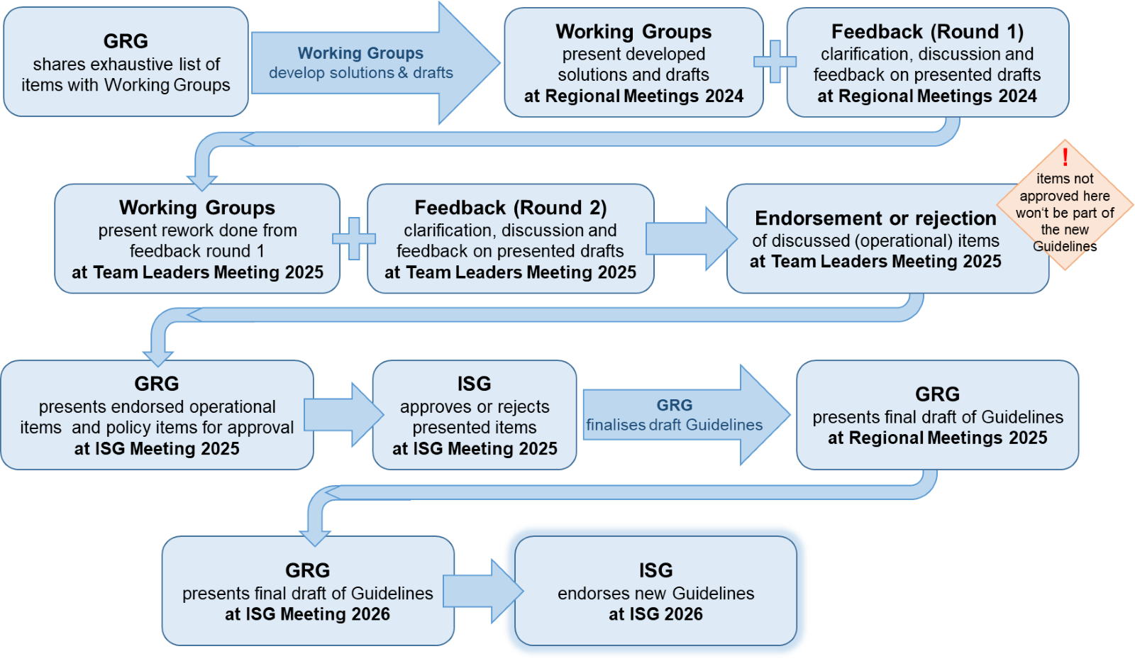
Timeline and Feedback loop

Slide 30
Timeline and Feedback loop
> 200 pieces of Feedback

Slide 31
Timeline and Feedback loop

Slide 32
Volume Numbering
Volume 1 – Policy (formerly Vol I)
Volume 2 – National Capacity Building (formerly Vol II A)
Volume 3 – Operations (formerly Vol II B)
Volume 4 – IEC/IER (formerly Vol II C)
Volume 5 – Field Operations Guide (formerly Vol III)

Slide 33
Volume 1 – Policy
(Former Volume I)
Speed of Activation – further explanation
Gender neutral text – all volumes
Restructure of volumes
New procedure for approval for medical practice
Add explanation of document structure (Binding or Non-binding) and English version as the binding version
Added, flexible response directory (capabilities and capacities on insarag.org)
Annexes, Guidance Notes, Forms and Checklists renamed to Appendix/Appendices)
Include quarterly induction for new focal points
Warsaw Declaration and Humanitarian Clause added

Slide 34
Volume 2 – National Capacity Building
(Former Volume II Manual A)
Renamed to: National Capacity Building
Introduced Chapter 2 - Overview of the National Capacity Building Process
National USAR Framework includes guidance on coordination
Appendices 2.2, 2.3 & 2.4 are on NCBWG work plan
  USAR Response Capacity Building
    Include multi-hazard or modular approach
    Medium National USAR teams suggested to have both search dog and technical search

Slide 35
Volume 2 – National Capacity Building
(Former Volume II Manual A)
Receiving International Assistance
  Expanded how affected country receives international assistance
  Guidance on requests, integration, logistical support, donations etc
(Civil) Host Nation Support (HNS)
  Role of the civil host national government and integration to national system
  National Quality Assurance
    NAP process updates (ex: Field Exercise set to 36 hours)
  IRNAP
    Reduced description of IRNAP process to avoid duplication
    Incorporated lessons learned from IRNAP processes in Americas and AP regions
    Eliminated “orange” from IRNAP checklist
    10 year duration recognition to be included

Slide 36
Volume 3 – Operations
(Former Volume II Manual B)
Triage categories provided for in UC Handbook, temporary Addendum 3.2
Information Management Section moved to UC Handbook (Appendix 3.1 wip)
Added VOSOCC status to response cycle
Emphasis on post mission reports, including analysis and coordination
MWG changes as directed
Changed product names related to ICMS collection tools
Added relevant ICMS information to align with UC Handbook
USAR Response Capacity Building
  Add zone definition
  Add sector and sub-sector to glossary
Incorporated the related Türkiye and Syria AAR findings

Slide 37
Volume 4 – IEC/IER
(Former Volume II Manual C)
INSARAG network obligations of classified teams reviewed and enhanced
Flexible duration of IEC/R (possible 36-48 hour)
IER application clarified
Inclusion of enhanced care to trapped live victims.
  Increased and more specific requirements for medical scenarios
  Added USAR medical knowledge to be involved with EXCON when developing scenarios for IEC/R

Slide 38
Volume 5 – Field Operations guide
(Former Volume III)
Incorporated the related Türkiye and Syria AAR findings
ICMS 3.0: Result of the Türkiye and Syria AAR and workshops/consultations:
  Simplification – Data collection reduction
  Flexibility – Coordination layers
  Worksite ID – Delinking from sectors – (NZL01- 0007)
  Alignment of terminology across all INSARAG platforms (www.insarag.org, ICMS, VOSOCC (wip))
  Updates and simplified paper forms
  Persona based information displays

Slide 39

Other Items
Flood Capability Directory on insarag.org (voluntary basis for classified USAR teams)
Countries affected by extreme flooding can request international assistance
Development of a Technical Reference on Search and Rescue in Flood Response
Reference for INSARAG members
Possible future expansion
USAR Coordination Handbook (Appendix 3.1)
TWG reviewing and wip
Triage Categories under review - TLM
Web and App based Guidelines
Browser, Android, iOS
Easy to disclose, search and find
Easier to administer
Including ‘paper’ versions (pdf)
Quick first impression of proof of concept

Slide 40
Next steps
That the 2020-26 GRG be transitioned to an ‘Interim’ GRG (2026-2030)
The new 2026 INSARAG Guidelines will take effect on 1 January 2027
Teams undertaking IEC/R in 2026 may use the existing version of the Guidelines.
Teams undertaking IEC/R in 2027 and onwards must use the new 2026 version.
Any technical questions should be directed to your regional representatives.
The Guidelines are available online on 10 July 2026.
Notes:
This slide is for Team Leaders and Regional Meetings.

Slide 41
Next steps
That the 2020-26 GRG be transitioned to an ‘Interim’ GRG (2026-2030)
The new 2026 INSARAG Guidelines will take effect on 1 January 2027
Teams undertaking IEC/R in 2026 may use the existing version of the Guidelines.
Teams undertaking IEC/R in 2027 and onwards must use the new 2026 version.
Any technical questions should be directed to your regional representatives.
The Guidelines are available online on 10 July 2026 at:
https://insarag-guidelines.netlify.app
Notes:
This slide is for the Global Meeting

Slide 42
GRG Statement
We would like to extend our heartfelt thanks to everyone who has contributed to the development of these guidelines. In particular, we would like to thank the members of the GRG, other Working Groups and the Secretariat for their support.
The dedication, generosity, and willingness of contributors to share their time and expertise has been essential in delivering the 2026 INSARAG Guidelines.
These guidelines will undoubtedly play a critical role in saving lives, coordination and enhancing international collaboration in disaster response and we are deeply grateful for your commitment to this vital work.
Martin Evers (the Netherlands) John Cawcutt (Australia)
Co-Chair GRG Co-Chair GRG

Slide 43
THANK YOU!

Slide 44
4
Session 4:
Information Management Working Group updates

Slide 45


Slide 46

ICMS 3.0
Team Leaders Briefing
IMWG, Implementation, Operations & the Journey to 3.0
Team Leaders Meeting | Brazil, July 2026 | INSARAG IMWG
Notes:
Title: ICMS 3.0 Team Leaders Briefing
- Purpose: brief on ICMS 3.0, the network's new information management system, ahead of the July 2026 launch.
- Scope: the drivers for change, what is new, the field workflow, and the transition every team must plan for.
- Format: high level, roughly ten minutes, questions held to the end.
[Delivery: Section divider style, keep to about 20 seconds.]

Slide 47








Session Overview
01 IMWG Mandate & Deliverables
02 The Turning Point
03 Design Principles
Who the IMWG is and what it delivered in 2025/26
Türkiye 2023 and the Qatar AAA&R
What ICMS 3.0 was built to solve
04 Field Operations
05 Coordination Layer
06 Training Pathway
QuickCapture, Field Maps & your workflow
RDC, UCC and Command Point
Online certification and face-to-face
07 Transition & Next Steps
08 ICMS 3.0 demo
09 Menti-meter – What do want
July 2026 onward
Team Leaders meeting 2026
Team Leaders meeting 2026
10 IMWG Member Countries
INSARAG IMWG | Team Leaders Meeting | Brazil, July 2026
Notes:
Session Overview (agenda)
- Six parts: the turning point, design principles, field ops, coordination, training, and transition.
- Flag up front that the last two, training and transition, carry the actions for teams.
- Everything before them is context so those actions make sense.
[Delivery: Walk the six parts quickly, do not dwell.]

Slide 48
01
IMWG Mandate & 2025/26 Deliverables
What the IMWG is mandated to do, and what it delivered this year
Notes:
Section 01: The Turning Point
- Set up why ICMS had to change: Turkiye 2023 and the Qatar After Action and Review.
- One line: the system that served the network stopped scaling under real pressure.
[Delivery: Divider, about 10 seconds.]

Slide 49
The IMWG: Mandate and Role in the Network
Mandate
Why this matters
Develop, deliver and promote effective information management solutions across the INSARAG network.
Support coordinated, timely and informed decision-making during time-critical USAR operations.
Maintain and improve the tools, methods, training and support needed to make coordination work in the field.
Information management is not an administrative function — it is an operational enabler.
It connects national authorities, LEMA, UCC, RDC, team leadership and field elements.
Better prioritisation and clearer situational awareness directly influences where limited resources are deployed.
When information works well, coordination works well. When coordination works well, more lives are saved.
Mandated under UN General Assembly Resolution 57/150 (2002).
Core Terms of Reference
Procedures
Technology
Documentation
Training & Education
Software
Compatibility
Technical Support
INSARAG IMWG | Team Leaders Meeting | Brazil, July 2026
Notes:
The IMWG: Mandate and Role in the Network
- Mandate in one line: develop and deliver information management that supports timely, informed decisions in time-critical USAR.
- The terms of reference span procedures, technology, documentation, training, software, compatibility, and technical support.
- The point to land: information management is an operational enabler, not admin; it is mandated under UN resolution 57/150, and when information works, coordination works and more lives are saved.
[Delivery: Land the 'operational enabler' point, do not read the ToR list.]

Slide 50
2025/27 Key Deliverables
ICMS 3.0 — Alpha Testing
ICMS 3.0 — Pre-Beta Testing
ICMS 3.0 — Beta Testing (Tinglev)
Alpha phase completed during an INSARAG External Reclassification exercise. System performance validated at team and coordination level.
Remote pre-beta testing conducted with IMWG members and Regional Chairs. Broad network engagement across regions.
Successful Beta test during the EU MODEX exercise in Tinglev, Denmark. Cross-network validation completed.
User Manuals Developed
Online Training Platform
ISG Endorsement — Funding Model
Clear and concise user manuals produced across all ICMS 3.0 modules. Deadline met for launch readiness.
Online, self-guided training and micro-modules built. Expected to meet training needs of ~85% of INSARAG team members.
Network-wide sustainable funding model endorsed by the INSARAG Steering Group, Geneva, 25 March 2025.
INSARAG.ORG – Website redevelop
Future IM Products
Delivery of ICMS3.0 to network
Update and modernise the insarag.org website, BETA version developed working with stakeholders on content and final format 2026
Menti-meter about what products are important to you, examples: Classifier tool, website review, working with stakeholders and working groups
Delivery of final version of ICMS 3.0 v1.0 to the network post the INSARAG Global Meeting and full implementation in Feb 2027.
INSARAG IMWG | Team Leaders Meeting | Brazil, July 2026
Notes:
2025/26 Key Deliverables
- A full ICMS 3.0 test cycle was completed: alpha at a reclassification exercise, pre-beta with members and Regional Chairs, and a successful beta at EU MODEX in Tinglev, Denmark.
- Launch-readiness products delivered on deadline: user manuals across all modules, and a self-guided online training platform covering roughly eighty-five percent of members.
- Governance milestone: the Steering Group endorsed the sustainable funding model in Geneva in March 2025.
[Delivery: Group into test cycle, launch-readiness, and governance.]

Slide 51
02
The Turning Point
Türkiye 2023 · Qatar AAA&R · Why ICMS had to evolve
Notes:
Section 01: The Turning Point
- Set up why ICMS had to change: Turkiye 2023 and the Qatar After Action and Review.
- One line: the system that served the network stopped scaling under real pressure.
[Delivery: Divider, about 10 seconds.]

Slide 52
Türkiye 2023: Scale Changed Everything
199
49
9,739
330
300+
Rescue teams
at peak
INSARAG
classified teams
Search & rescue
personnel
Search
dogs
Lives
saved
Unprecedented operational tempo: the network deployed across multiple sectors simultaneously, testing every layer of coordination.
System stress revealed: ICMS 2.0 held but showed clear friction under volume, speed and connectivity pressure.
The defining lesson: information management systems must perform when the operational tempo is highest — not just in steady state.
INSARAG IMWG | Team Leaders Meeting | Brazil, July 2026
Notes:
Turkiye 2023: Scale Changed Everything
- Largest INSARAG response on record: 199 teams and close to 9,700 personnel working multiple sectors at once.
- ICMS 2.0 held, but showed clear friction under volume, speed, and poor connectivity.
- The lesson driving 3.0: the system must work hardest exactly when operational tempo is highest.
- Be ready to defend the figures if challenged; they are the deck's stated numbers, not verified live.
[Delivery: Do not read every number, land the so-what.]

Slide 53
Qatar AAA&R: Six Things the Network Said Had to Change
1. Simpler & faster
2. Minimum vital information
3. Flexible tasking
Forms and workflows were too extensive for the early life-saving phase.
Clarity on what is truly essential, especially in the initial operational period.
Support for work areas and variable operating patterns beyond linear worksite logic.
4. Lower bandwidth burden
5. Paper and digital together
6. Use information for decisions
Connectivity issues, repeated logins and offline-capable modes were critical requirements.
Updated procedures recognising simultaneous paper and digital information management.
ICMS must support operations and planning — not simply reproduce forms digitally.
INSARAG IMWG | Team Leaders Meeting | Brazil, July 2026
Notes:
Qatar AAA&R: Six Things That Had to Change
- These six requirements came straight from operators at the After Action and Review.
- First group: make it simpler and faster, capture only vital information early, and support flexible tasking.
- Second group: lower the bandwidth burden, run paper and digital together, and use the data for decisions, not just digital forms.
[Delivery: Group the six, do not read them line by line.]

Slide 54
03
Design Principles
From lessons identified to a new operational system
Notes:
Section 02: Design Principles
- Move from lessons identified to what was actually built.
- One line: the shift is from filling in forms to running an operational system.
[Delivery: Divider, about 10 seconds.]

Slide 55
What Changed: ICMS 2.0 → ICMS 3.0
ICMS 2.0
ICMS 3.0
Complex, admin-heavy field forms
Simple, user-first design — 90 sec → 15 sec capture
Disconnected systems
Integrated ecosystem: one data model, shared event
Duplicate data entry
Capture once, reuse everywhere across all functions
Static or delayed COP
Real-time, dynamic Common Operating Picture
Manual reporting burden
Automated outputs from field data in the system
Optimised for large events only
Scalable: exercises, small incidents, major deployments
INSARAG IMWG | Team Leaders Meeting | Brazil, July 2026
Notes:
What Changed: ICMS 2.0 to 3.0
- Six shifts on the table; the headline is capture time dropping from ninety seconds to fifteen.
- Capture once, reuse everywhere: the same data is not re-keyed across functions.
- One data model feeds a real-time common operating picture, and it scales from an exercise to a major deployment.
[Delivery: Lead with the headline number, then two principles.]

Slide 56
04
Field Operations
QuickCapture · Field Maps · Two-stage data capture · Your workflow
Notes:
Section 03: Field Operations
- This is the part most field elements will actually touch.
- Three things coming up: QuickCapture, Field Maps, and a two-stage capture model.
[Delivery: Divider, about 10 seconds.]

Slide 57
The ICMS 3.0 Ecosystem: How the Layers Connect
FIELD LAYER
QuickCapture · Field Maps · Photos · GPS
COORDINATION LAYER
RDC · UCC · Triage · Tasking · COP
COMMAND LAYER
Command Point · Situational Awareness · Reporting
HUB / ACCESS
Single event entry · Role-based access · INSARAG Hub
The system moves trusted information upward while keeping role-specific utility at each layer.
INSARAG IMWG | Team Leaders Meeting | Brazil, July 2026
Notes:
The ICMS 3.0 Ecosystem: How the Layers Connect
- Four connected layers: field, coordination, command, and a shared hub for access.
- One event, role-based access: people see what their role needs and nothing more.
- Principle: trusted information moves upward while each layer keeps its own utility.
[Delivery: Explain the shape, not every label.]

Slide 58
QuickCapture: Fast, First-Contact Field Data
What QuickCapture Does
Two-Stage Capture Model
One-tap capture — GPS auto-stamp, time-stamp, photo
Triage categories A, B, C, D — camera-first workflow
Works on 3G / 4G / 5G / Starlink and offline
Sync queue — data pushes when connection restores
Designed for capture under pressure, not desk use
Capture time: 15 seconds vs 90 seconds in ICMS 2.0
STAGE 1
QuickCapture
Fast first contact: GPS, photo, triage category, victim count. Priority is speed — every second counts.
STAGE 2
Field Maps
Richer data entry: worksite detail, hazards, access, progress notes. Can be completed at CP or later.
INSARAG IMWG | Team Leaders Meeting | Brazil, July 2026
Notes:
QuickCapture and the Two-Stage Model
- QuickCapture is the first-contact tool: one tap stamps GPS, time, and photo and sets a triage category, in about fifteen seconds.
- It works offline and across everything from 3G to Starlink, queuing data and syncing when connection returns.
- Two stages: capture fast on arrival, then add the detail in Field Maps back at the Command Point or later.
[Delivery: Emphasise speed and the offline behaviour.]

Slide 59
Your Field Workflow: Step by Step
01
02
03
04
05
Arrive at Worksite
Capture First Data
Assign Triage Category
Submit & Sync
Update via Field Maps
Assess scene safety
Activate QuickCapture
Worksite ID · GPS
Victim count
A – Confirmed <12h
B – Confirmed >12h
C – Unconfirmed
D – Deceased only
Push when connected
Offline queue syncs automatically
Progress notes
Extrication updates
Hazard changes
INSARAG IMWG | Team Leaders Meeting | Brazil, July 2026
Notes:
Field Workflow: Step by Step
- Five steps: arrive and assess safety, capture first data, assign triage, submit and sync, then update via Field Maps.
- Triage runs A to D: confirmed under twelve hours, confirmed over twelve hours, unconfirmed, and deceased only.
- The sync step is automatic; an offline queue pushes as soon as a connection is available.
[Delivery: Trace the five steps in one pass.]

Slide 60
05
Coordination Layer
RDC · UCC · Command Point — three roles, one information environment
Notes:
Section 04: Coordination Layer
- This is where field data becomes coordinated action.
- Three roles, RDC, UCC, and Command Point, working in one shared information environment.
[Delivery: Divider, about 10 seconds.]

Slide 61
Coordination Apps: Three Roles, One System
RDC
UCC
Command Point
Who is arriving and what capability is entering theatre?
What is happening in sectors and where should teams be assigned?
What does team leadership need to understand and act on now?
Team registration and INSARAG ID entry
Resource manifests — personnel and equipment
Team status: In-transit / In-AO / Departing
Handover to UCC for tasking
Triage prioritisation and worksite assignment
Real-time COP with sector and team tracking
QA on incoming field data
Logistics, operations, photo-linked reporting
Team-level operational and situational view
Receive taskings from UCC
Assign squads and brief team leaders
Report back: status, extrications, updates
INSARAG IMWG | Team Leaders Meeting | Brazil, July 2026
Notes:
Coordination Apps: Three Roles, One System
- RDC manages arrivals: team registration, INSARAG ID, resource manifests, and team status.
- UCC runs the picture: triage prioritisation, worksite assignment, the real-time COP, and quality checks on field data.
- Command Point is the team-level view: receive taskings, assign squads, and report status back up.
[Delivery: One clean line per role.]

Slide 62
06
Training Pathway
Online certification · Face-to-face · Train the Trainer
Notes:
Section 05: Training Pathway
- How people get qualified on the system.
- Three routes: online certification, face-to-face, and train-the-trainer.
[Delivery: Divider, about 10 seconds.]

Slide 63
ICMS 3.0 Training: How to Get Qualified
1
2
3
Online Self-Paced
Certification
Face-to-Face & TOT
Interactive online training covering ICMS 3.0 tools and methodology. Complete at your own pace — available through the INSARAG training platform.
Upon successful completion of online training you receive a certificate of completion — the prerequisite for all face-to-face UCC-level training.
In-person step-over training for UCC and advanced roles. Train-the-Trainer courses for ICMS 2.0 champions and power users moving to the 3.0 ecosystem.
Completion is mandatory to attend UCC courses
Similar to BSAFE certification model
95% of users require field apps training only
INSARAG IMWG | Team Leaders Meeting | Brazil, July 2026
Notes:
ICMS 3.0 Training: How to Get Qualified
- Online self-paced comes first: it covers the tools and method and is the mandatory gate for any UCC course.
- Completion earns a certificate, the same model as BSAFE, and that certificate is the prerequisite for all face-to-face training.
- Reassurance for commanders: about ninety-five percent of users need the field apps only; face-to-face and TOT are for UCC and advanced roles.
[Delivery: End on the reassurance about the 95 percent.]

Slide 64
07
Transition & Next Steps
July 2026 — February 2027 transition · What you need to do
Notes:
Section 06: Transition and Next Steps
- This is the part every commander must plan around.
- The transition window runs July 2026 to February 2027, with clear actions attached.
[Delivery: Divider, about 10 seconds. Signal this is the action part.]

Slide 65
Transition Timeline: ICMS 2.0 to ICMS 3.0
July 2026
July – Feb
Feb 2027
Ongoing
ICMS 3.0
Launched
Dual-System
Period
ICMS 3.0
Mandatory
Sustainment
& Support
Endorsed at Team Leaders
and Global Meetings
Both ICMS 2.0 and 3.0
are available for use
ICMS 2.0 is retired.
Only ICMS 3.0 in use
Online platform,
desk support, updates
Key message: Complete your online training before your next deployment. Teams must be certified before attending UCC-level courses. The dual-system period allows teams to familiarise — from February 2027, ICMS 3.0 is the only system in use.
INSARAG IMWG | Team Leaders Meeting | Brazil, July 2026
Notes:
Transition Timeline: ICMS 2.0 to 3.0
- July 2026: 3.0 launches, endorsed at the Team Leaders and Global meetings.
- July to February is a dual-system window, both versions running so teams can familiarise.
- From February 2027, 2.0 is retired and 3.0 is the only system; sustainment and support continue after that.
[Delivery: Three dates plus the dual-system point.]

Slide 66
What Team Leaders Need to Do
NOW
Complete online ICMS 3.0 training
Access via the INSARAG training platform. Certificate required for UCC courses.
NOW
Brief your team
Ensure all field elements understand QuickCapture and the two-stage capture model before your next exercise or deployment.
BEFORE FEB 2027
Run at least one ICMS 3.0 exercise
Use the dual-system period productively. Test the workflow under exercise conditions and identify any team-specific gaps.
BEFORE FEB 2027
Confirm UCC staff are certified
Any team member in a UCC, RDC or CP role must hold ICMS 3.0 online certification before the mandatory transition date.
INSARAG IMWG | Team Leaders Meeting | Brazil, July 2026
Notes:
What Team Leaders Need to Do
- Two things now: complete the online training, and brief field elements on QuickCapture and the two-stage model.
- Before February 2027: run at least one exercise on 3.0 to surface any team-specific gaps.
- Also before the deadline: confirm anyone in a UCC, RDC, or CP role holds ICMS 3.0 certification.
[Delivery: This is the ask. Slow down and be explicit.]

Slide 67
ICMS 3.0 Technical Demonstration
Run through of the lifecycle of an ICMS event/worksite
Notes:
Discussion and Questions
- Close: the system is ready, the network is ready, and the transition starts now.
- Single most important takeaway: online training done before the next deployment.
- Open for discussion; the contact address on screen is for any follow-up.
[Delivery: Close firmly, then open the floor.]

Slide 68
Discussion & Questions
ICMS 3.0 is ready. The network is ready. The transition starts now.
INSARAG Information Management Working Group | insarag.imwg@gmail.com
Notes:
Discussion and Questions
- Close: the system is ready, the network is ready, and the transition starts now.
- Single most important takeaway: online training done before the next deployment.
- Open for discussion; the contact address on screen is for any follow-up.
[Delivery: Close firmly, then open the floor.]

Slide 69
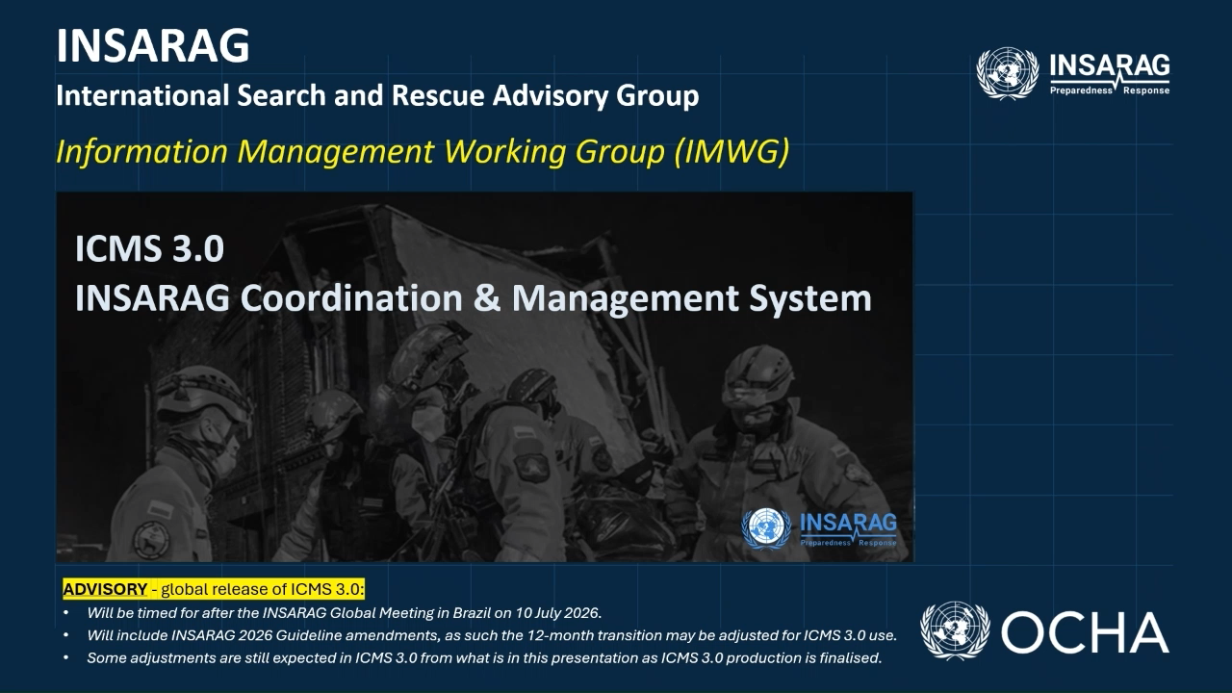
Notes:
Discussion and Questions
- Close: the system is ready, the network is ready, and the transition starts now.
- Single most important takeaway: online training done before the next deployment.
- Open for discussion; the contact address on screen is for any follow-up.
[Delivery: Close firmly, then open the floor.]

Slide 70
LUNCH BREAK
Session 5 will begin at 13:45

Slide 71
5
Session 5:
USAR Coordination Handbook

Slide 72
TEA/COFFEE BREAK
Session 5 will continue at 15:45

Slide 73
6
Session 6:
Search and Rescue in Flood Response, latest developments
Notes:
Letter 2 of 3 From Emily to WG co-chairs/Chairs

Slide 74
INSARAG Flood Response Working Group Work Plan
This table aligns INSARAG Strategic Objectives with the FRWG Terms of Reference
Strategic Objectives | Quality Standards | Localisation | Flexible Response | Working Group Commitment Communication Plan
2026/27 Deliverables & Targets | Update Technical Reference Note (TRN). Target: Dec 2026 Review SAR-FR Directory procedures. Target: Dec 2026 Contribute to INSARAG Guidelines review. Target: Completed | Expand SAR-FR Directory. Target: 20% increase in listed capabilities. Develop capacity-building framework for non-developed bilateral partners. Target: June 2027 | Deliver knowledge-sharing events. Target: 2 webinars delivered. Create lessons library. Target: 10 resources uploaded. | Maintain active regional membership. Target: ≥3 active members in each region. Sustain engagement. Target: 75% meeting attendance. Conduct working group meetings. Target: 4 on-line and 1 in person. Report to INSARAG forums. Target: 3 annual progress updates
Notes:
Deliberate approach to setting and communicating a clear strategic direction for the WG:
Anchor strategy in the purpose and vision
Environmental scan and stakeholder engagement
Translate strategy into actionable priorities
Build a culture of accountability and innovation
Communication and engagement
Monitor evaluate and continuous improvement
Lead by example
Chair, Members of the Steering Group, thank you for the opportunity to brief you.
I’m here to report on what the Search and Rescue in Flood Response Working Group has delivered.
Firstly, recognise the 19 members of the working group who have representation across the 3 regions.
And to seek your endorsement to extend the Working Group so these outcomes can be consolidated and operationalised.
This briefing is focused on three things:
1. Why this Working Group remains strategically relevant,
2. What we have delivered against your direction,
3. And why a time‑bound extension is necessary to protect and embed that value.
This is not about expanding scope, but about finishing the job properly.

Slide 75
7
Session 7:
11 years on, The INSARAG Recognized National Accreditation Process (IRNAP). How IRNAP contributes to the localization of the response.
Notes:
Letter 2 of 3 From Emily to WG co-chairs/Chairs

Slide 76
Closing of Day 1 & Review of Day 2 Agenda

Slide 77
Thank you!

Slide 78
INSARAG
International Search & Rescue Advisory Group
Team Leader Meeting
​
6-7 July 2026
Foz do Iguaçu, Brazil

Slide 79
Welcome Address – Day 2

Slide 80
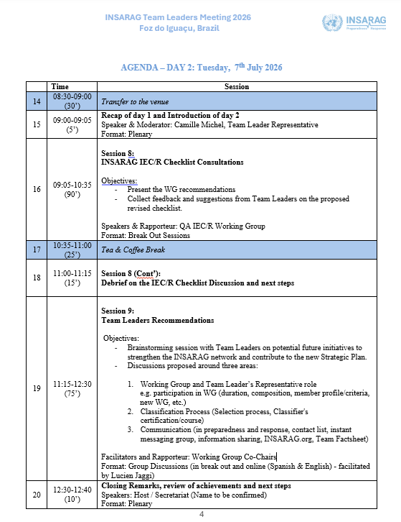
Agenda – Day 2
Notes:
TO BE UPDATED

Slide 81
8
Session 8:
INSARAG IEC/R Checklist Consultations

Slide 82

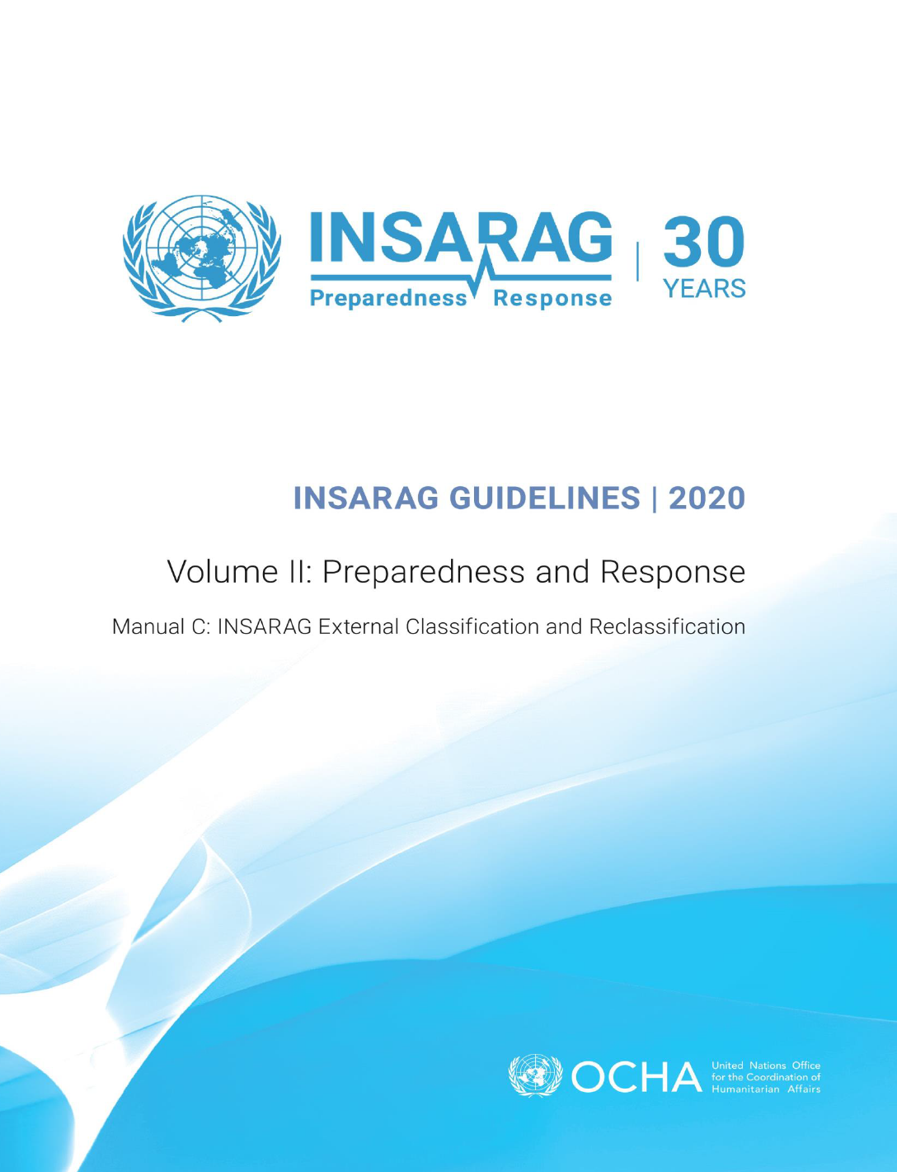
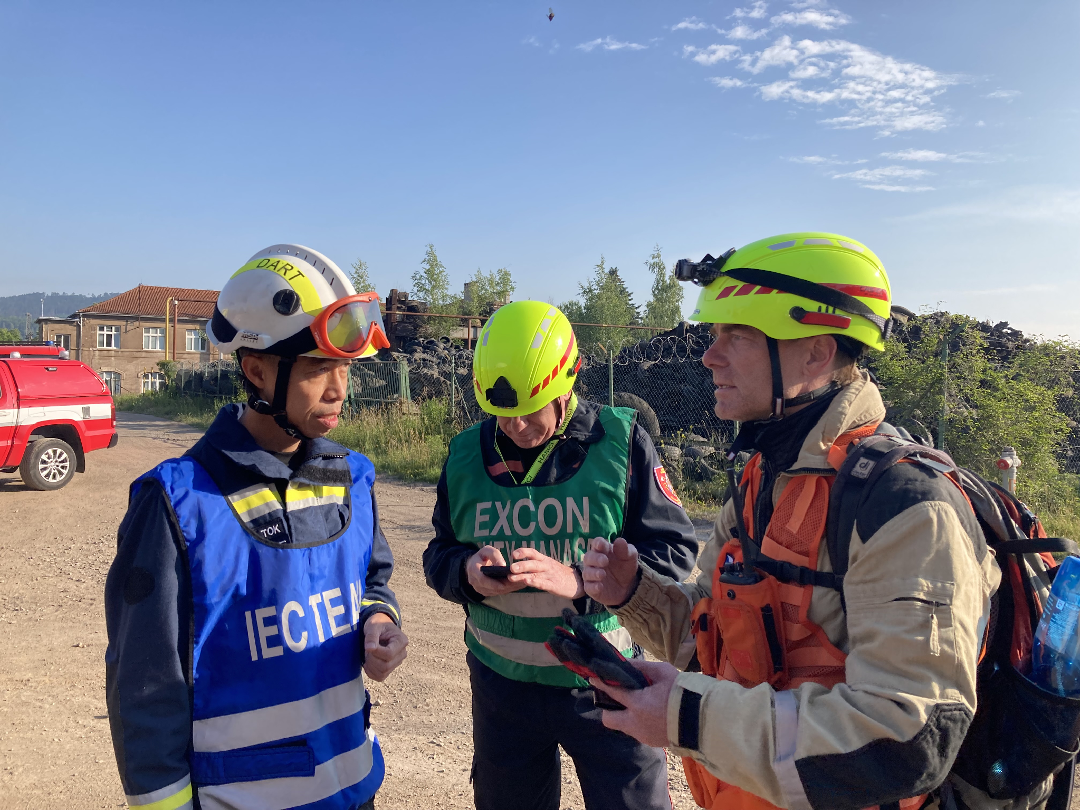
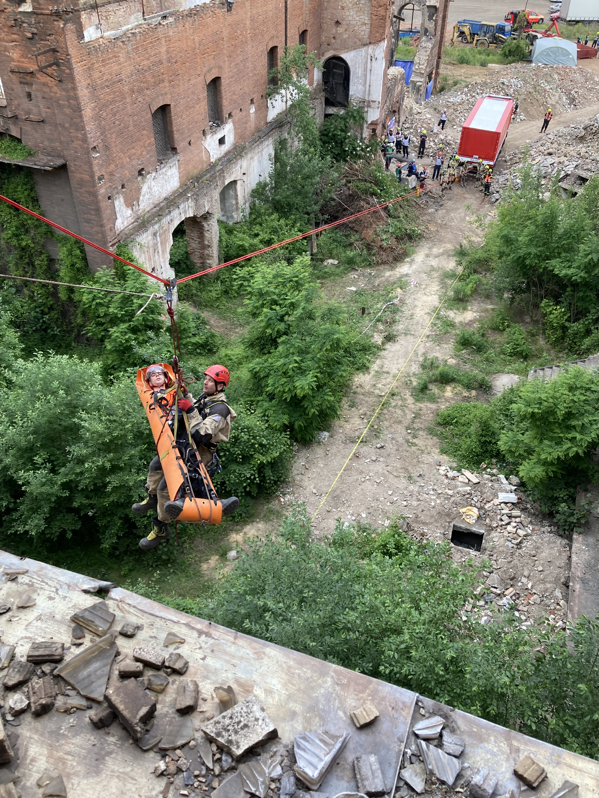
IEC/R Quality Assurance WG
Global Meeting 3 – 11 July, Foz do Iguacu/Brazil
20th Anniversary of the INSARAG IEC/R System 2025
Reflecting on Two Decades of Quality Assurance in USAR

Slide 83
TORs and Assignment
The IEC/R Review WG was established in 2019 after an external IEC/R review of the processes was conducted. On 26 May 2020 the ISG endorsed this new WG.
The IEC/R Quality Assurance WG will be conducted within the framework of the GRG in coordination with the other involved WGs and focus on all aspects of the review of the IEC/R process described in the INSARAG Guidelines Vol II, Manual C and include:
Review and Global discussion on IEC/R process
Review and Global discussion IEC/R checklist
Review and Roles and Responsibilities of IEC/R cadre and the FPs (policy-, operational-, team-)
Discuss how to enhance the quality and preparation of the classifiers
Discuss the compliance of all stakeholders to the IEC/R process described in Guidelines Vol 4
Support the INSARAG Secretariat in reviewing
(1) IEC/R applications on compliance to the minimal standards
(2) IEC/R cadre for upcoming IEC/Rs

Slide 84
IEC/R QA WG Members
Ms. Annika Coll | AEME | Medium | NGO
Mr. David Sochor | AEME | Heavy | Governmental
Mr. Mark Crowe | AP | Heavy | Governmental
Mr. Adam Bradley | Americas | Heavy | Governmental
Mr. Philippe Besson | AEME | Medium | NGO
Mr. Irakli West | AEME | Light | NGO
Mr. Ivan Koval | AEME | Heavy | Governmental
Mr. Lee Ivory | AEME | Heavy | Governmental
Mr. Martin Pavek | AEME | Heavy | Governmental

Slide 85
IEC/R Quality Assurance - WG
1
Review of INSARAG Guidelines Vol II, Manual C 🡪 New Vol 4
4
Review IEC/R application clarified
2
Review of INSARAG IEC/R Checklist within the 5-year cycle
5
Discuss how to support the INSARAG Secretariat during IEC/R Process
3
QA of classifiers by the developement of training package
6
Review of PoE Format and content

Slide 86
Reason and history of review of the IEC/R Checklist
Lack of clarity of IEC/R checklist for some classifiers and TLs
New appearing technologies in USAR
Focus on the WHAT (goal/task to be achieved) more than on the HOW (process)
Reduction of Costs
* Quality assurance must remain granted
Discussions & Involvement with the network:
> Qatar 23 - Belo Horizonte 24 - Bucharest 24 - Tunis 25 - Geneva 25 - Prague 25
> Checklist changes have been consulted in detail with the team
leaders this Monday 6
> Endorsement is planned by ISG in Geneva (March 2027)

Slide 87
Proposed Changes for IEC/R Checklist
  The IEC/R Checklist has been cleaned up as follows:
Layout slightly adapted to become more user-friendly
Alignment of Order & Chronology of points 1 to 6 (Day 1 – Day 3)
Wording more clear for teams and classifiers (e.g.diagonal stabilization; raker shore; 4 dogs minimum for heavy teams)
New Additions | Amendments
ISG decision that classified teams have to offer/provide classifiers More consideration to National legislation and standards (e.g. confined/restricted space; shoring/stabilization, and operations in general) Technologies (e.g. tech search is now open, hot cutting has been removed) Medical; based on proposals from the medical WG: impalement | Crane operation (weight from 5T to 1T and only 1 operation) Ropework reduction from 10 to 7 metres Flexible duration of IEC/R (between 36 – 48hrs on request by team and coordination with IEC/R Cadre)

Slide 88
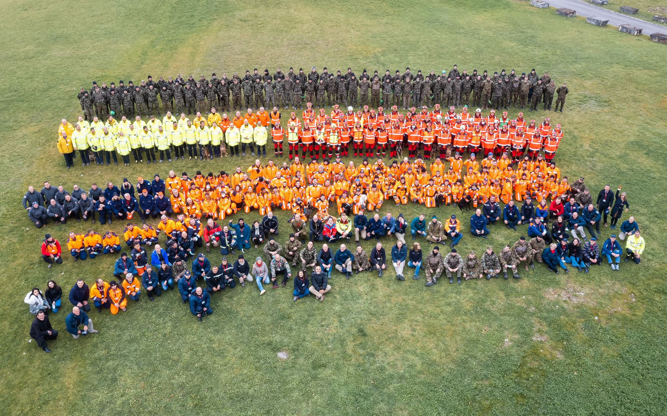
Thank You
Notes:
Together we make the difference

Slide 89
TEA/COFFEE BREAK
Session 8 will begin at 11:05

Slide 90
8
Session 8b:
Debrief on the IEC/R Checklist Discussion and next steps

Slide 91
9
Session 9:
Team Leaders Recommendations

Slide 92
1
0
Session 9:
Closing Remarks, Review of Achievements and Next Steps

Slide 93
Thank you!

