Slide 1

First Responder 2.0
Community Responder Training
Session 09
Session 09
Presentation Title:
Presentation Title:
Lifting/Moving
Presenter/Instructor:
Presenter/Instructor:
<Name>
Coordination Saves Lives
Coordination Saves Lives

Slide 2
Lifting / Moving
Community Responder Training
How to lift and move heavy debris
Effect on the debris
Safety precautions
Coordination Saves Lives

Slide 3
Lifting and Moving Operations
Avoid
work around the debris
if unstable: keep everyone at a safe distance
Move
if you can’t avoid it, move it
use gravity and the terrain to assist
secure it once moving is completed
Lift
only if you cannot safely avoid / move the debris
support the debris as you lift
secure it in place once lifting is completed

Slide 4
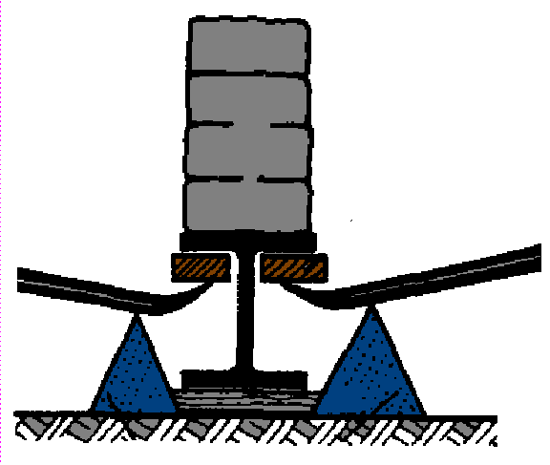
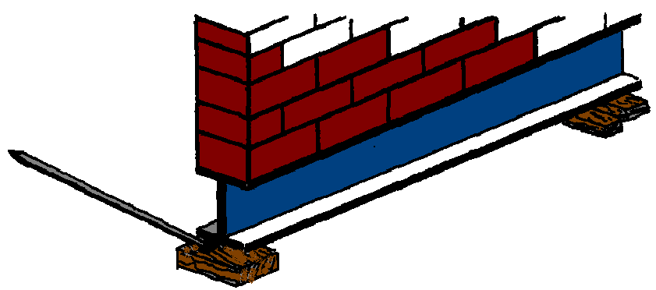
Lifting: using crowbars
Layer of wood
Never use metal or stone/bricks! (they will slip or break)
Pivotal point
Notes:
Never use a layer of metal (slipping danger) or stone/bricks (breaking danger)!

Slide 5
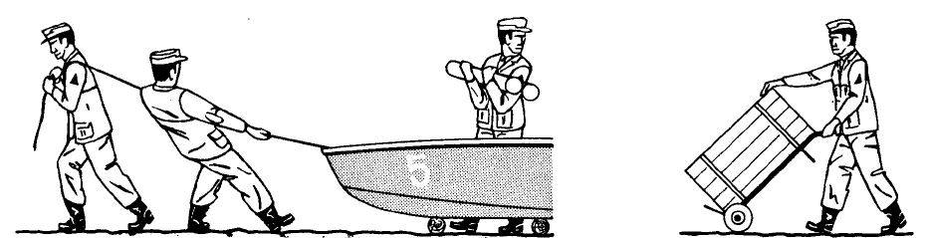
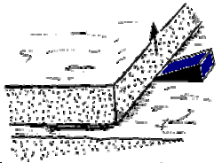
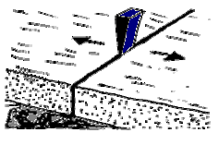
Moving: Using various tools

Slide 6




Moving: Securing the layer / Subbase
Always use wedges when lifting or lowering a load.
Use wedges always in pairs, otherwise there is a high risk of load movement due to slipping of the load an the wedge.

Slide 7
Moving: Secure the load by using wedges
Always use wedges when lifting or lowering a load.
side view
parallel to the object
top view
inclined to the object

Slide 8

Moving: Cribbing method
Cribbing is used to hold / bear the load by a construction of wood. To avoid slipping there is always a pair of cribs used!
The timber wood is pre-cut rectangular.

Slide 9
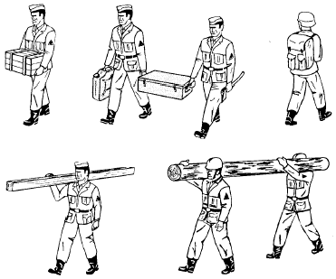
Lifting: Transporting loads by hand
Take care for your back! Don‘t over act, but share load if possible!
Don‘t twist the load! Carry long load only on the same side of your shoulders!

Slide 10
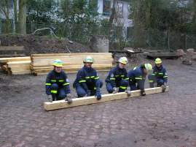
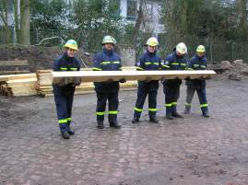
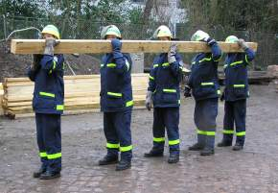
Lifting: Transporting loads by hand
Picking up the load:
A clearly formulated order is needed for a safe procedure. This avoids injuries and risky situations.
The last person in the row is always the one giving orders.

Slide 11
Lifting: Transporting loads by hand
1. Order:
Rescuers move toward the load, order comes: „Take load! – Ready?“
– “Yes!”
All persons must answer the question „Ready?“ clearly with a „Yes!“. Only if all answered „Yes“ the next order comes.

Slide 12
Lifting: Transporting loads by hand
1. Order:
Rescuers move toward the load, order comes: „Take load! – Ready?“
– “Yes!”
2. Order:
„Lift - up!“
Holding load in arm crook safely „Ready?“– “Yes!”
All persons must answer the question „Ready?“ clearly with a „Yes!“. Only if all answered „Yes“ the next order comes.

Slide 13
Lifting: Transporting loads by hand
1. Order:
Rescuers move toward the load, order comes: „Take load! – Ready?“
– “Yes!”
2. Order:
„Lift - up!“
Holding load in arm crook safely „Ready?“– “Yes!”
3. Order:
„On shoulder, hold secure and – Move on!“
All persons must answer the question „Ready?“ clearly with a „Yes!“. Only if all answered „Yes“ the next order comes.

Slide 14

?
вопросов
问题
La question
Fragen
सवालों के जवाब
kysymykset
vragen
perguntas
domande
Questions
الأسئلة
въпроси
質問
Cuestión
sorular
otázky
pertanyaan
küsimused
spørgsmål

