Slide 1

First Responder 2.0
Community Responder Training
Session 08
Session 08
Presentation Title:
Presentation Title:
Search
Presenter/Instructor:
Presenter/Instructor:
<Name>
Coordination Saves Lives
Coordination Saves Lives

Slide 2
Search
Community Responder Training
  Basic search methods
Coordination Saves Lives

Slide 3
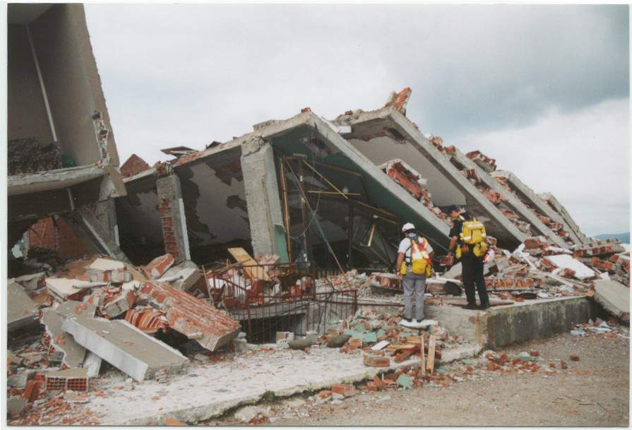
Our Goal
being aware of the need for structured search techniques
being able to lead and conduct search operations
being capable to help in
a safe and effective way

Slide 4
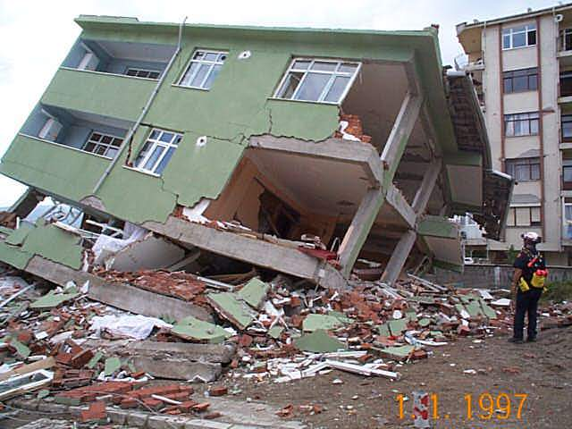
Objectives
recognizing the skills and knowledge to undertake physical search strategies

Slide 5
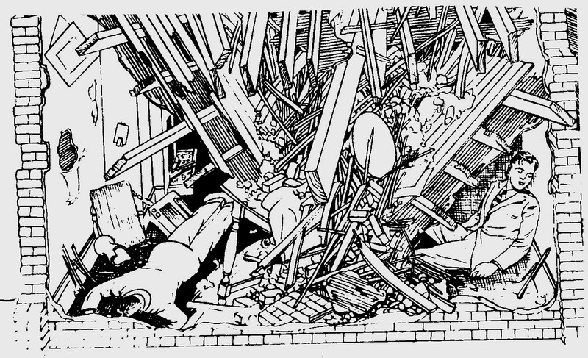
Do you remember?
15% of victims are trapped in void spaces

Slide 6
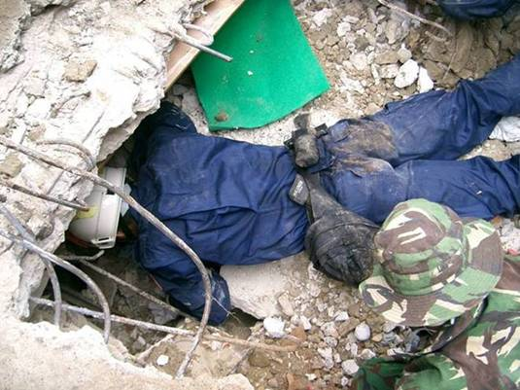
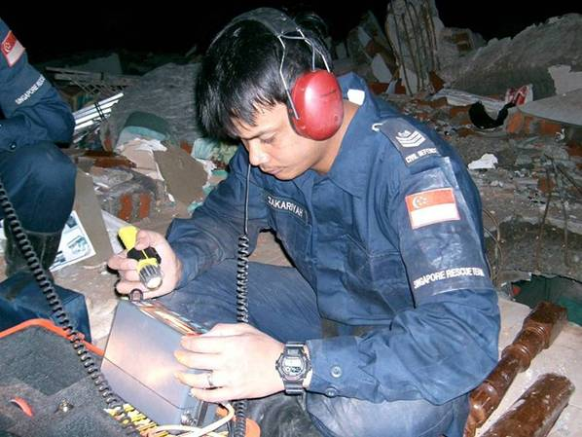
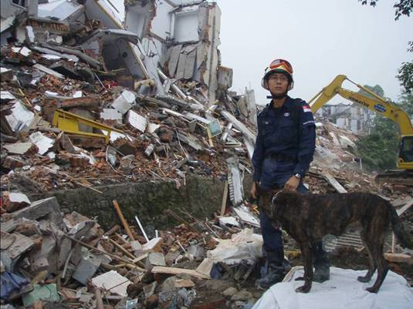
Search Methods by Professionals
Physical search
Canine search
Technical search

Slide 7
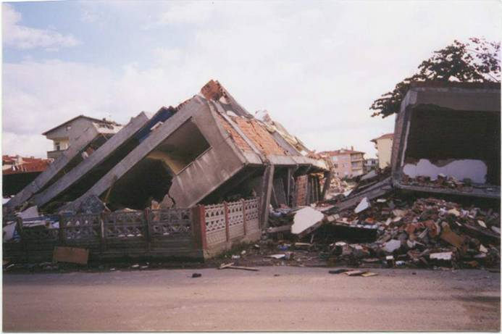
Possible Location of Void Spaces
Structurally resistant areas:
Basements
Bathrooms
Inside hallways
Concrete walls
Stairwells
Elevator shafts
Kitchens

Slide 8
Search Management
Primary (hasty) search
Secondary (extensive) search
    Line and Hail Search
    Circle and Hail Search

Slide 9
Search Management – Primary Search
team of ca. 10-12 responders
a plan which area to search
communicate and coordinate
move quickly through a designated area where a person might be injured or trapped
move as a team in an organized manner (no one working alone)
record information
look for clues and signs

Slide 10
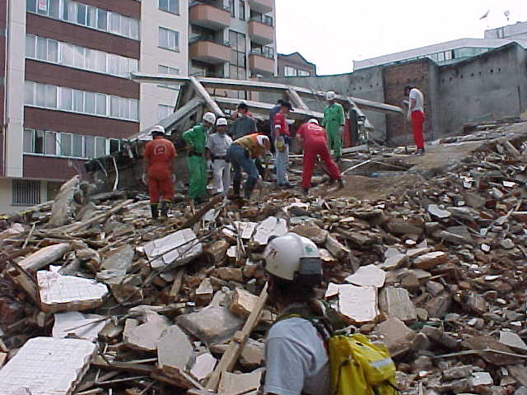
Search Management – Primary Search

Slide 11
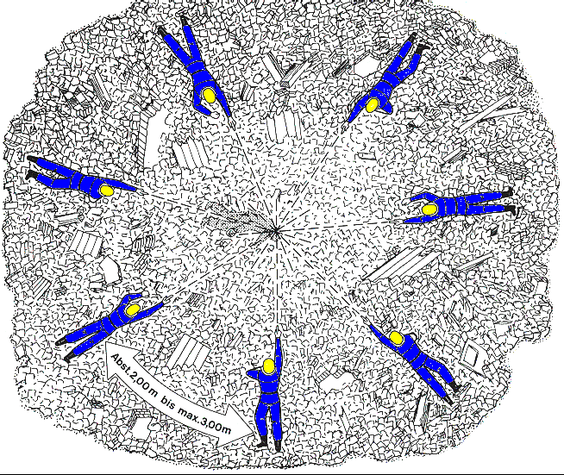
Search Management – Secondary Search
Circle & Hail Method
Form a circle with max. 3m between the rescuers.
Yell loudly: „Search and rescue here, can anybody hear me?“
Remain silent to hear for answers.

Slide 12
Search Management – Secondary Search
Line & Hail Method
Form a line with max. 4m between the rescuers.
Yell loudly: „Search and rescue here, can anybody hear me?“
Remain silent to hear for answers.

Slide 13
Group Work:
The instructor divides you into smaller groups.
With his/her help you will successfully conduct a line and hail search.
Notes:
Practical exercise for 15 min. – Line and Hail Search
Group size ca. 5 people

Slide 14

?
вопросов
问题
La question
Fragen
सवालों के जवाब
kysymykset
vragen
perguntas
domande
Questions
الأسئلة
въпроси
質問
Cuestión
sorular
otázky
pertanyaan
küsimused
spørgsmål

