Slide 1

First Responder 2.0
Community Responder Training
Session 07
Session 07
Presentation Title:
Presentation Title:
Rescue Methodology
Presenter/Instructor:
Presenter/Instructor:
<Name>
Coordination Saves Lives
Coordination Saves Lives

Slide 2
Rescue Methodology
Community Responder Training
Basic introduction to
Standard Operating Procedures on site
Coordination Saves Lives

Slide 3
Before Rescue Works Starts
Collect as much information as possible for the decision-making process (start of rescue activity)
via observation 360°
by examination of the debris
by asking survivors

Slide 4
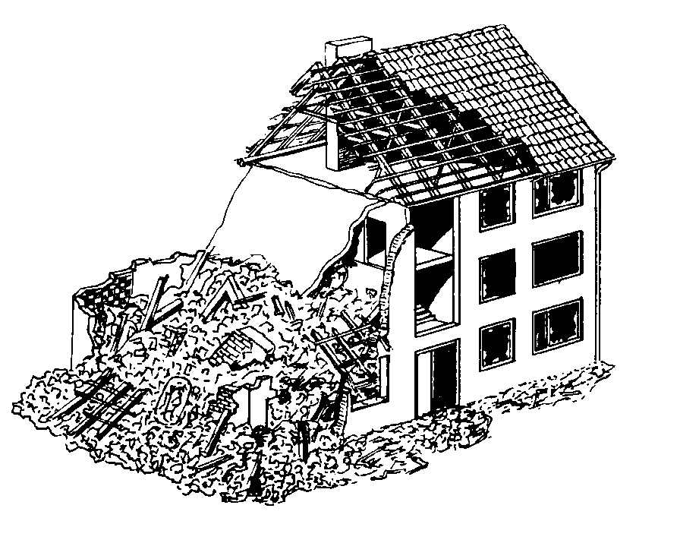




Before Rescue Work Starts - Securing the site
Keep people out of the danger zone!
Search operations need silence and
for rescue activities you need space.
2-3 m

Slide 5
Before Rescue Work Starts – Manage Observers
“The others“ might not understand why it takes long, but try to keep the work site free from bystanders as they will not bring benefits for your work, slow you down and possibly endanger themselves.
2-3 m

Slide 6

Before Rescue Work Starts – 360°Assessment
Try to see the site from all angles,
pay attention to
collapse patterns
leaks (water, gas, etc.)
surrounding structures
Don‘t forget to look upwards!

Slide 7







Before Rescue Work Starts – Assessing Damage
Compact layers
Half room
Blocked room
Partial damaged room
Debris
Rubble pile
Half filled room
good practice: use symbols and drawings!

Slide 8

Before Rescue Work Starts – Minimizing Risk
Look for additional dangers such as:
gases
power lines
fires
acids
falling objects
unstable building parts

Slide 9
Before Rescue Work Starts – Information
Valuable information could be given
about people in the house, like
„In which part of the house was the missing person last seen?“
„How is the house structured? Where is the bathroom/living room/etc. located?“
Never forget to ask survivors, neighbours or police, fire fighters and civil protection.

Slide 10
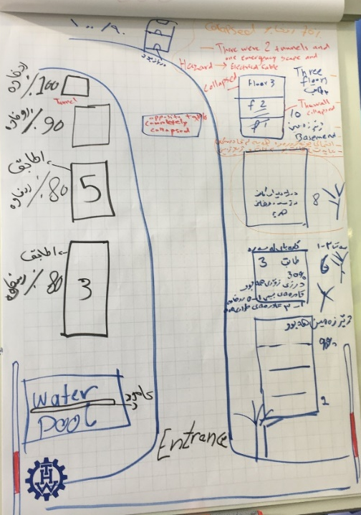
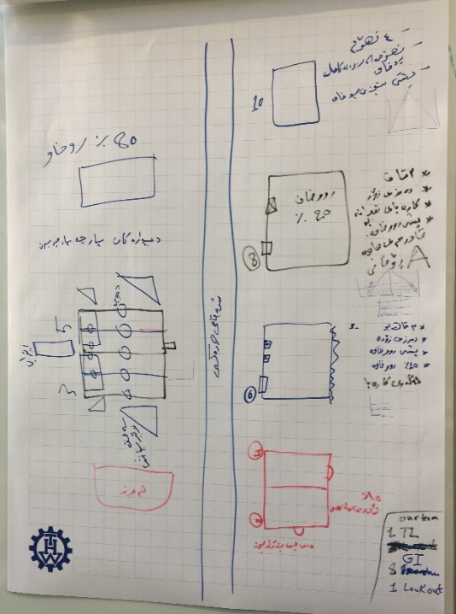
Before Rescue Work Starts – Information
Don‘t wait to document your findings.
Stress level rise, things might be forgotten!

Slide 11
Rescue Work Starts – Search and Rescue
The task is to search for victims. If located you try to rescue them. But if rescue is not possible write down all details and try to inform professionals.
For a successful first response
be aware of your limitations
balance means and needs well, and
plan ahead (anticipation)

Slide 12
Rescue Work Starts – Your Plan of Action (PoA)
All actions are to be done safely and in an efficient way.
plan carefully
limit time spent in the danger zone
use all human resources
always have your own safety in mind
act
think & plan
observe

Slide 13
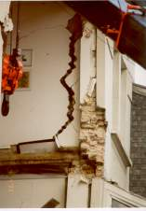
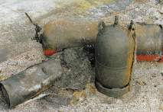
It is the details that matter!
Verify, discuss, rethink strategy – better slow down than haste!

Slide 14

?
вопросов
问题
La question
Fragen
सवालों के जवाब
kysymykset
vragen
perguntas
domande
Questions
الأسئلة
въпроси
質問
Cuestión
sorular
otázky
pertanyaan
küsimused
spørgsmål

