Slide 1

First Responder 2.0
Community Responder Training
Session 06
Session 06
Presentation Title:
Presentation Title:
Coordination and Planning of rescue work
Presenter/Instructor:
Presenter/Instructor:
<Name>
Coordination Saves Lives
Coordination Saves Lives

Slide 2
Coordination and planning of rescue work
Community Responder Training
  How to use collated information
Coordination Saves Lives

Slide 3
We learned so far:
As Community Responders we can work effective and rescue people, by having the knowledge of:
where to find victims
risks and dangers
being a rescuer/rescue team
being safe
doing assessment and sector dividing
… what is missing now?

Slide 4

Group Work
Split up in two groups and discuss:
What is missing for successful rescue work?
What to do with all the gathered information?
... 20 minutes …
Notes:
Trainer must guide the teams if needed. Key elements to find: Coordination and Planning. Also being aware: We are not alone, there more of us in each sector, we can support each other. Finally: the overall work site safety. 20 minutes for discussion and 5 minutes per group to present the results

Slide 5
Coordination is missing!
You are not alone, there will be many more people on site.
Working together in a coordinated and organized way, you can:
organize tools (like timber, tools, first aid kits, etc.)
set priorities for worksites
co-operate with professionals in difficult rescues
organize professional medical posts for victims
make sure that all buildings will be assessed

Slide 6
Planning – to take the long view
Community Responders must have a vision of how to work effective, no matter if professional or non-professional. There are just 120 hours to rescue!
Plan ahead:
shifting and resting time for rescuers
finding new people who join the rescue team
next steps to take

Slide 7
Safety – you can not help others if you’re hurt
There will be many worksite to help at the same time. To keep everyone safe you need a clear definition for:
safe zones
  Where is it okay to go to?
hazardous areas
  Where nobody should go and/or needs to be very careful?
outsiders
  Where and how do you keep bystanders out of dangerous areas?
control
  Who is in charge to look after your safety rules?

Slide 8
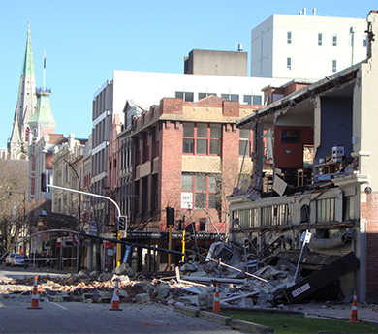

Safe Zones
Safe zones are where people can gather, are treated for injuries or equipment can be laid out etc.
Safe zones should be marked or signs put up, so that people know about them.
Safe Area

Slide 9
Hazardous Areas
Community Responders should be able to define general areas where it is not safe to be. Access to these areas should be restricted.
As a rule of thumb, use:
height of the structure × 1,5
10 m × 1,5 = 15 m
10m
Safe Area
Danger Zone
15m

Slide 10
Controlling the Scene
… means to be in charge of your surroundings. After disasters, there are often bystanders who are not involved in search & rescue works. But they might hamper them!
To avoid that, you can
get the assistance of police or military personnel
set up boundary markers, entry and exit points
exclude people not involved in rescue operations
make arrangements for residents to return to their homes as soon as possible

Slide 11

?
вопросов
问题
La question
Fragen
सवालों के जवाब
kysymykset
vragen
perguntas
domande
Questions
الأسئلة
въпроси
質問
Cuestión
sorular
otázky
pertanyaan
küsimused
spørgsmål

