Slide 1

First Responder 2.0
Community Responder Training
Session 05
Session 05
Presentation Title:
Presentation Title:
Information gathering
Presenter/Instructor:
Presenter/Instructor:
<Name>
Coordination Saves Lives
Coordination Saves Lives

Slide 2
Information Management
Community Responder Training
Assessing the neighbourhood
How to get the big picture
How to set priorities
Coordination Saves Lives

Slide 3
Assessing the neighbourhood
gather information
How many victims? What is damaged? Are there hazards?
divide affected area into manageable sectors
use streets, rivers or the like as boundary
record information
write it down, make drawings
collect information
have a specific person or place where to collect all gathered information
use information to make a plan of action

Slide 4
Recording and collecting information:
make notes during assessment, take pictures and draw maps and plans
collect all information at a central point
use the information to prioritize worst affected areas
share the information with all First Responders and use it to make a  Plan of Action

Slide 5
Plan of Action
… is a detailed plan defining actions needed to reach one or more goals
What to do?
Who does it?
When to do it?
How long will it take?
This plan has to be updated constantly!

Slide 6
Information needed for a good assessment
 | 1. Victims | 2. Damage | 3. Hazards
Information | How many victims? Where are they? Are they trapped/ injured? How to access them?
Actions

Slide 7
Information needed for a good assessment
 | 1. Victims | 2. Damage | 3. Hazards
Information | How many victims? Where are they? Are they trapped/ injured? How to access them?
Actions | observation interview survivors take notes mark debris or buildings

Slide 8
Information needed for a good assessment
 | 1. Victims | 2. Damage | 3. Hazards
Information | How many victims? Where are they? Are they trapped/ injured? How to access them? | What is damaged? How bad, stable/ unstable is it? Are roads and bridges usable? Are utilities damaged?
Actions | observation interview survivors take notes mark debris or buildings

Slide 9
Information needed for a good assessment
 | 1. Victims | 2. Damage | 3. Hazards
Information | How many victims? Where are they? Are they trapped/ injured? How to access them? | What is damaged? How bad, stable/ unstable is it? Are roads and bridges usable? Are utilities damaged?
Actions | observation interview survivors take notes mark debris or buildings | observation, listen take notes draw or mark maps take videos and photographs

Slide 10
Information needed for a good assessment
 | 1. Victims | 2. Damage | 3. Hazards
Information | How many victims? Where are they? Are they trapped/ injured? How to access them? | What is damaged? How bad, stable/ unstable is it? Are roads and bridges usable? Are utilities damaged? | Where are hazards? Which areas are safe? How stable is the debris? Are there leaks or spills? Is there fire or smoke?
Actions | observation interview survivors take notes mark debris or buildings | observation, listen take notes draw or mark maps take videos and photographs

Slide 11
Information needed for a good assessment
 | 1. Victims | 2. Damage | 3. Hazards
Information | How many victims? Where are they? Are they trapped/ injured? How to access them? | What is damaged? How bad, stable/ unstable is it? Are roads and bridges usable? Are utilities damaged? | Where are hazards? Which areas are safe? How stable is the debris? Are there leaks or spills? Is there fire or smoke?
Actions | observation interview survivors take notes mark debris or buildings | observation, listen take notes draw or mark maps take videos and photographs | observation implement a safe zones take notes draw or mark maps take videos and photographs

Slide 12

Group Work!
You were given some information sheets with pictures of damaged buildings. Please discuss with your neighbour:
Are those buildings possible worksites for Community Responders?
Write down which information seems important to you and should be collected!
... 15 minutes …
Notes:
15 Minutes max.! Examples must be localized!

Slide 13
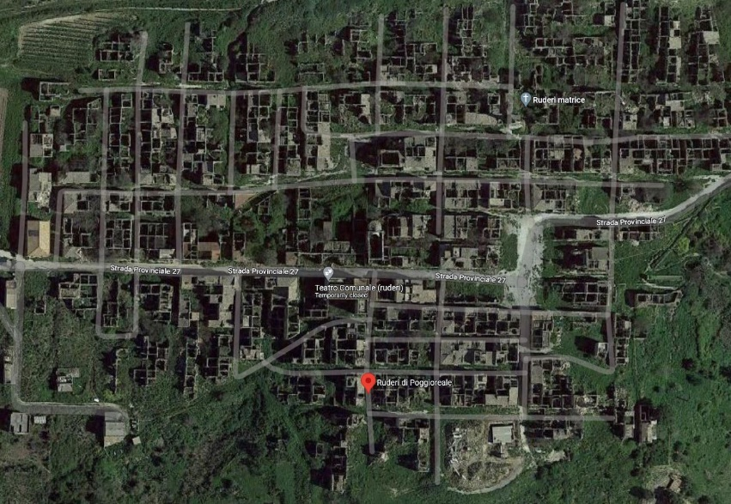
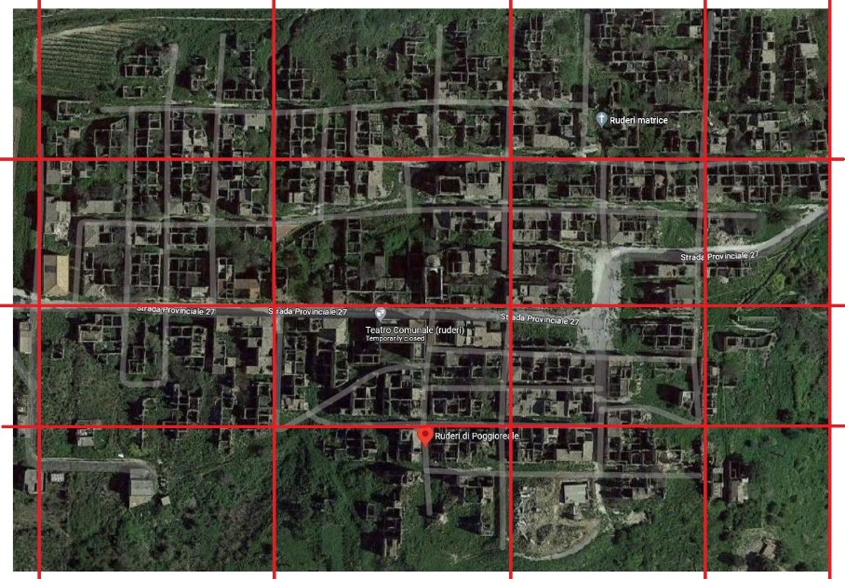
Sectors – what is it and why to use it
Large areas can be confusing, dividing it into smaller sectors helps to keep a better overview in bigger villages or cities.

Slide 14
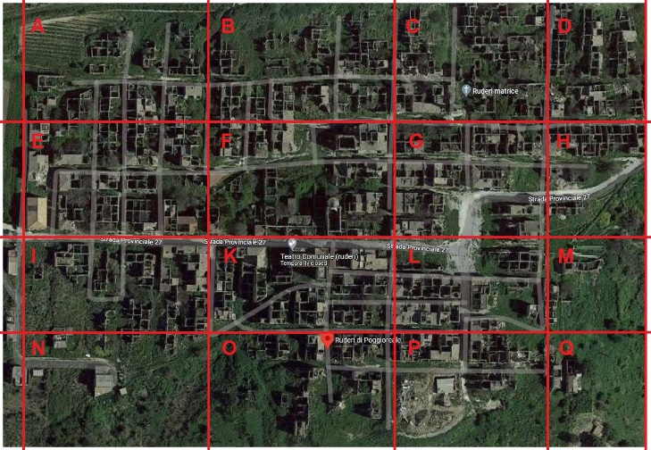
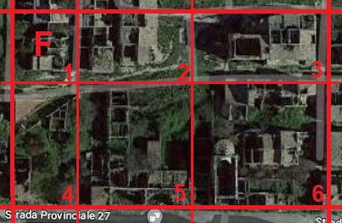
Sectors – what is it and why to use it
mark buildings already assessed or searched
prioritize sectors worst affected
avoid doubling search by new arriving rescuers

Slide 15

?
вопросов
问题
La question
Fragen
सवालों के जवाब
kysymykset
vragen
perguntas
domande
Questions
الأسئلة
въпроси
質問
Cuestión
sorular
otázky
pertanyaan
küsimused
spørgsmål

