Slide 1

First Responder 2.0
Community Responder Training
Session 03
Session 03
Presentation Title:
Presentation Title:
What is a rescuer and how to stay safe on mission
Presenter/Instructor:
Presenter/Instructor:
<Name>
Coordination Saves Lives
Coordination Saves Lives

Slide 2
What is a rescuer and how to stay safe on mission
Community Responder Training
Basics on safety
Protective equipment
Coordination Saves Lives

Slide 3
A rescuer is person that is trained to work in a safe manner in a very risky environment.
As a Community Responder, rescue work will only be successful if you know your own weaknesses.
Own safety is the key element to avoid harm.

Slide 4
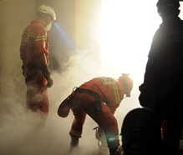
Being safe means being in control of hazards
To avoid or reduce the impact of hazards:
Use of Personal Protection
Controlling site access
Use of lookouts
Planning evacuation

Slide 5
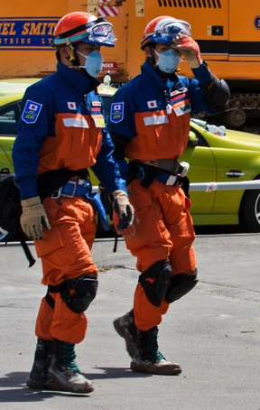
Personal protection
Protective clothing and equipment like:
a helmet or hard hat
a pair of leather gloves
a pair of boots or heavy shoes
safety glasses or goggles
protective clothes
a dust mask
… but what to do, if there is nothing available? How to protect?

Slide 6

Group Work!
A typical item available nearly everywhere are blankets from cotton.
Try to work out the following protective gear:
Gloves
Helmet
Knee protector
... max. 20 minutes!
Notes:
Two groups, max. 20 minutes to work out, each group explains the other group how they worked out (max. 5 min.)

Slide 7
Safety on the worksite is needed, too!
Community Responders have to work continuously in a risky environment. Some additional preparation will help to stay safe:
Using an look out as site observer
Using a warning signal to alarm rescuers
Having an evacuation plan
Having control on the work site
Notes:
Maxim

Slide 8
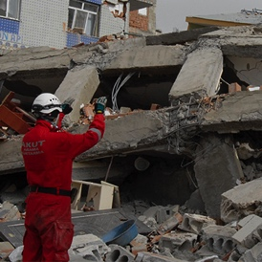
Use of lookouts (Observers)
When Community Responders are at a work site, they should have at least one lookout.
Their role is to watch out for hazards and warn everyone before an accident happens.

Slide 9
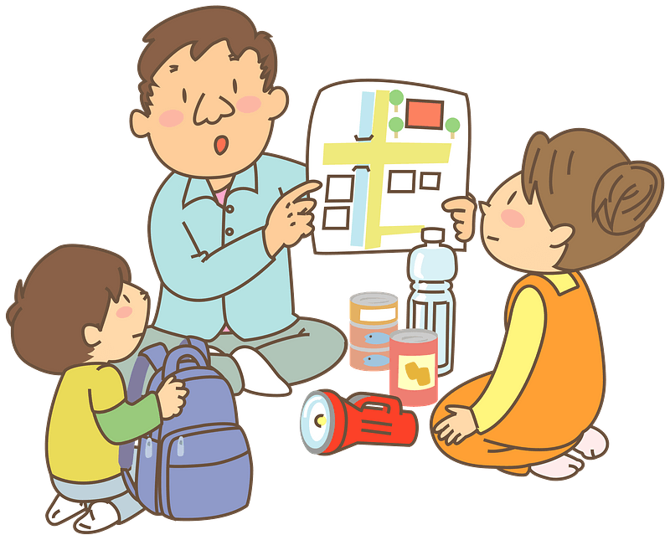
Planning an evacuation
It is important to have an evacuation plan at the worksite.
Tell everyone involved in the rescue works about it, so that they know what to do if an evacuation is necessary. Use signs, warning tape or the like to mark specific places and routes.

Slide 10
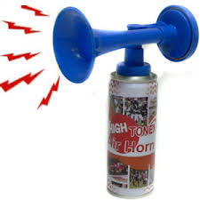
Planning an evacuation – the list
An evacuation plan should mention:
the alarming method
a whistle, a horn or shout
a safe place
where to evacuate to
one or more routes to take
how to get to the safe place
how to know if everyone evacuated
have a list or a tracking system in place
when and how to re-enter the worksite safely
new assessment of the site, things might have changed!

Slide 11
On-Site Management
Try to control the work site:
get the assistance of any police or military personnel
if no professionals present, select people to be safety managers
set up boundary markers, entry and exit points
keep people out who are not involved in rescue operations
make arrangements for residents to return to their homes (in or out?)

Slide 12

?
вопросов
问题
La question
Fragen
सवालों के जवाब
kysymykset
vragen
perguntas
domande
Questions
الأسئلة
въпроси
質問
Cuestión
sorular
otázky
pertanyaan
küsimused
spørgsmål

