Slide 1

Community Responder Training
Session 02
Presentation Title:
Disaster impact
Presenter/Instructor:
<Name>
Coordination Saves Lives

Slide 2
Disaster Impact
Community Responder Training
Hazards
Risks
Dangers
Coordination Saves Lives

Slide 3
The post disaster situation: risky for rescuers
Community Responders have little training and no personnel protective equipment.
That is why you need to pay special attention to hazards, risks and dangers on-site.
The following slides show some examples.

Slide 4
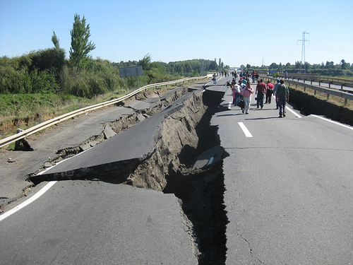
Damaged Infrastructure
Things to look out for
Missing street signs
Missing traffic control
No familiar landmarks
Loose power cables
Damaged or destroyed bridges
Blocked roads (for example through collapsed buildings and landslides)
Changed geography (different from maps)

Slide 5
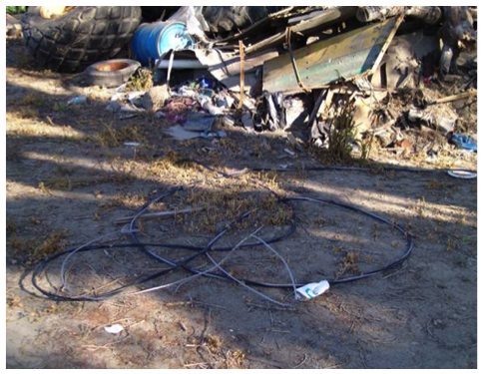
Damaged Utilities
Things to look out for
Gas leaks from broken pipes
listen and smell!
Water from broken pipes
Sewage leaks (pollution)
Broken wires and cables
assume they still hold electricity!
Broken telephone wires
they can touch power cables that hold electricity

Slide 6
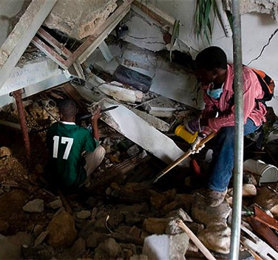
Unstable Structures
Things to look out for
Aftershocks
Hidden holes and voids
Dust and plaster falling
Any movement of debris
Movement of walls, floors, columns or beams
listen for creaking and groaning noises
Horizontal / vertical cracks appearing or widening

Slide 7
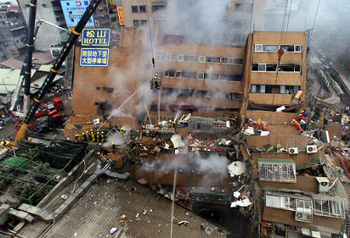
Fire and Smoke
Things to look out for
Smoke is toxic and makes you unconscious very quickly
avoid or reduce exposure
Debris or metal can be hot
test surfaces with the back of your hand
Fire can cause explosions
keep people outside of the danger zone
Heat can cause buildings to collapse

Slide 8
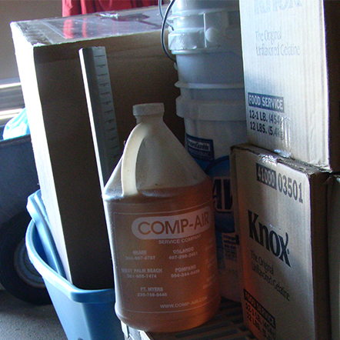
Chemical Hazards
Things to look out for
Regular household chemicals
when mixed they can become very dangerous
Gas cylinders
smell!
Leaking batteries
highly acid
Leaking chemical drums or tanks
Contaminated water with fuel & chemicals

Slide 9
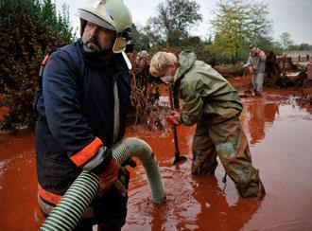
Environmental Hazards
Things to look out for
Contaminated water
toxic and/or infectious
Body fluids of victims
Weather conditions
cold or heat, high winds, snow, risk of flooding
Dust in the environment
protect eyes, nose and mouth of rescuers and victims!

Slide 10

Brainstorming:
You have 10 minutes to think about the following questions:
Which rules are important in a risky environment?
And which is the most important one?
... 10 minutes …
Notes:
Max. 10 minutes!

Slide 11
Brainstorming – possible results
Other rules are:
Never work alone
Don’t haste
Use all senses
Check twice before entering a structure / building
Protect yourself
…but most importantly: Safety First!
Be aware that your own safety is the key element for the rescue of victims.

Slide 12

?
вопросов
问题
La question
Fragen
सवालों के जवाब
kysymykset
vragen
perguntas
domande
Questions
الأسئلة
въпроси
質問
Cuestión
sorular
otázky
pertanyaan
küsimused
spørgsmål

