Slide 1

Community Responder Training
First Responder 2.0
Session 19
Session 19
Presentation Title:
Presentation Title:
Patient handling and transport
Presenter/Instructor:
Presenter/Instructor:
<Name>
Coordination Saves Lives
Coordination Saves Lives

Slide 2
Patient Handling and Transport
Community Responder Training
Extrication
Packing and transport
Coordination Saves Lives

Slide 3
Patient Packaging and Transport
make a plan how to move the patient
carry the patient or use a supportive element
move patients:
from the site of injury / illness to a holding point
from a holding point to a healthcare facility
transport may require moving patients over hazardous terrain

Slide 4
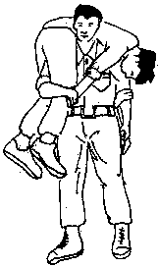
Patient Packaging and Transport Emergency casualty evacuation in the open
Fire Fighter’s Lift
one person operation
light casualty (unconscious)

Slide 5
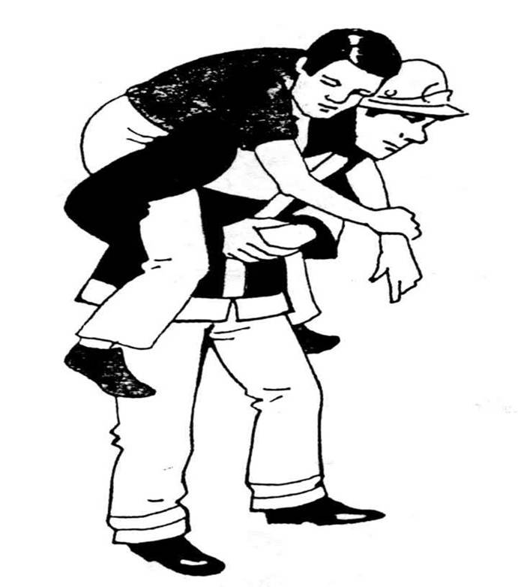
Patient Packaging and Transport Emergency casualty evacuation in the open
The Pick-a-Back
one person operation
heavier casualty
casualty is able to hang on
will not lose consciousness

Slide 6
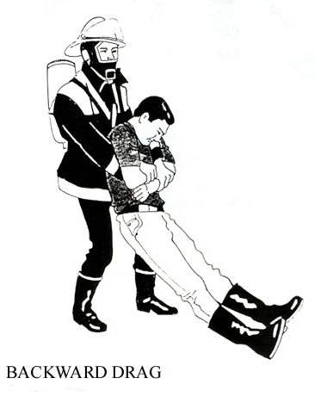
Patient Packaging and Transport Emergency casualty evacuation in the open
The Backward Drag
one person operation
casualty too heavy to be lifted

Slide 7
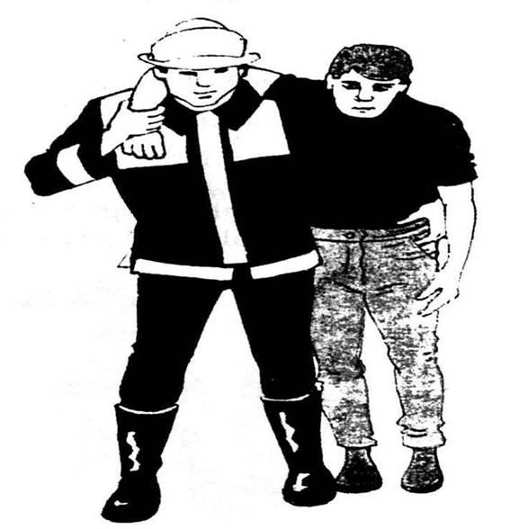
Patient Packaging and Transport Emergency casualty evacuation in the open
The Human Crutch
one person operation
casualty can walk but needs assistance

Slide 8
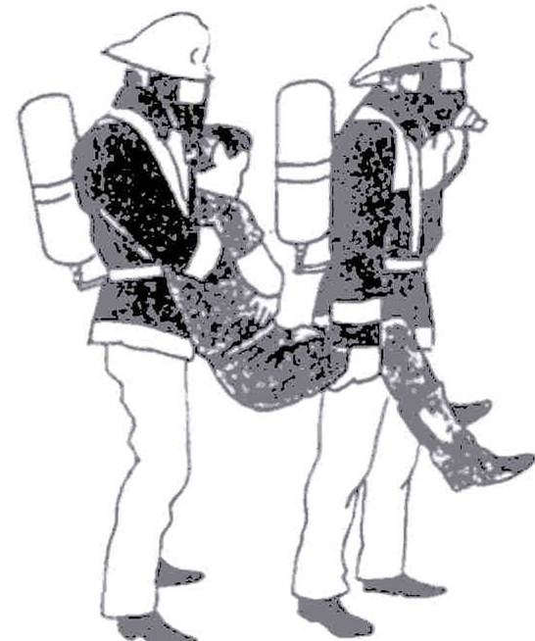
Patient Packaging and Transport Two Person Evacuation Techniques
The Fore and Aft
two person operation
casualty is unable to walk

Slide 9
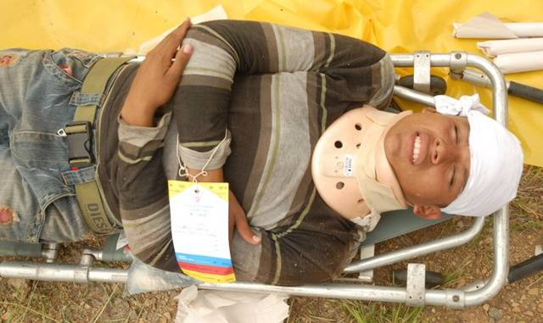
Using Tools for Transport
First Responders use these standardised tools such as the “stretchers” to transport a victim safely.

Slide 10
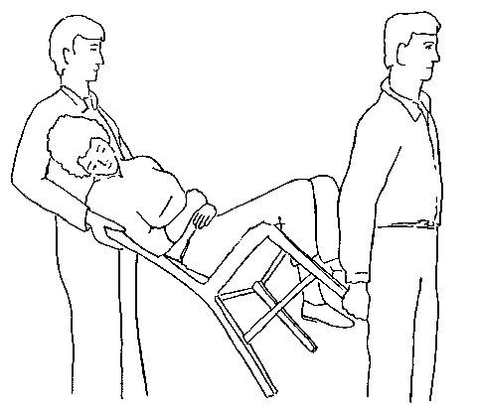
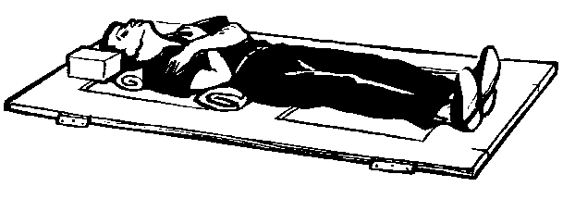
Using Tools for Transport
Community Responders must use any available tool that can be used as a carrier.
Doors and chairs are ideal as an improvised transport tool!

Slide 11
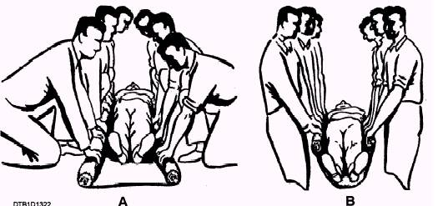
Using Tools for Transport
If there are no doors or chairs, even a strong blanket can be used as an improvised transport tool:

Slide 12
Patient Packaging and Transport
Casualty Holding Point
set up in a safe area close to where casualties are evacuated from the incident
Protected from falling debris
Up wind to avoid smoke, gas, dust and hazardous materials
Open area (after shock; secondary collapse)
an area with sufficient lighting
easy access for evacuation vehicles
does not disturb other rescue activities

Slide 13
Handling the Deceased
Community Responders will find many deceased persons. These persons need to be taken to an assembly point, if it is not too dangerous.
When moving the deceased:
use protection (gloves)
note from which point the deceased was removed
treat the body with dignity
have a plan of what to do with the deceased until they can be handed over
minimise public exposure (cover body)

Slide 14

?
вопросов
问题
La question
Fragen
सवालों के जवाब
kysymykset
vragen
perguntas
domande
Questions
الأسئلة
въпроси
質問
Cuestión
sorular
otázky
pertanyaan
küsimused
spørgsmål

