Slide 1

First Responder 2.0
Community Responder Training
Session 17
Session 11
Presentation Title:
Presentation Title:
Patient injuries
Presenter/Instructor:
Presenter/Instructor:
<Name>
Coordination Saves Lives
Coordination Saves Lives

Slide 2
Patient Injuries
Community Responder Training
Burns
Fractures
Bleedings
Impaled objects
Coordination Saves Lives

Slide 3
A real medical expert is needed
Community Responders usually have no skilled medical person in the team as the team is composed randomly after an earthquake. As a Community Responder, medical help will be limited to the basics.
First aid is important as nearly all victims have injuries, but a professional medical person should be integrated into the team as quickly as possible!

Slide 4
Patient Injuries: Burns
Common Types
thermal
dry burns (e.g. from fire, hot surfaces)
wet burns (e.g. from hot water, steam)
chemical
acids (e.g. hydrochloric acid)
alkalis (e.g. lime)
electrical (from contact with electrical current, arcing)

Slide 5
WARNING!
The following slides contain graphic material of wounds, burns, fractures, and other injuries!

Slide 6
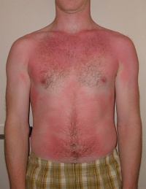
Patient Injuries: Burns
superficial burn

Slide 7
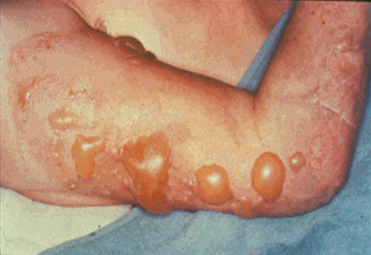
Patient Injuries: Burns
partial thickness burn
Warning!
explicit picture

Slide 8
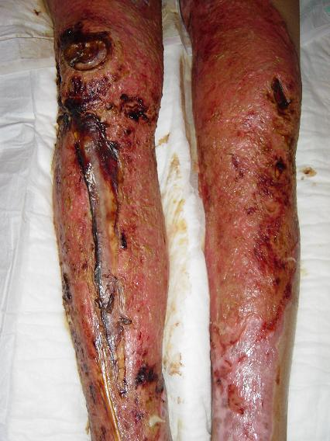
Patient Injuries: Burns
full thickness burn (often painless)
Warning!
explicit picture

Slide 9
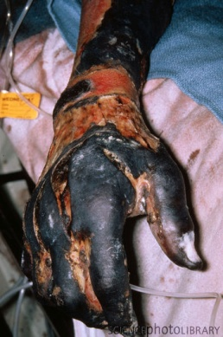
Patient Injuries: Burns
charring
Warning!
explicit picture

Slide 10
Patient Injuries: Burns
patients with extensive burns are prone to suffering from hypothermia (feeling cold)
if a burned patient starts to shiver or complains of feeling cold: stop cooling, cover to keep warm
transport as fast as possible to a medical facility

Slide 11
Patient Injuries: Fractures
Signs & Symptoms
pain
bleeding
internal if closed (Bruising)
external if open (risk of infection!)
swelling
instability
deformity
loss of function
open bone fracture

Slide 12
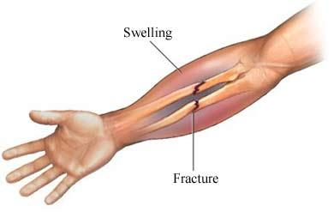
Patient Injuries: Fractures
can be closed / invisible

Slide 13
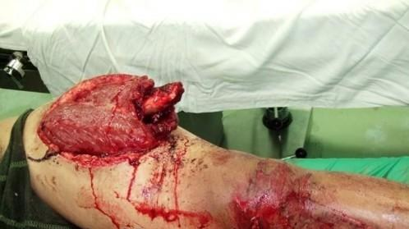
Patient Injuries: Fractures
can be open / visible
Warning!
explicit picture
Notes:
A fracture associated with an open wound is still considered an open fracture even if no bone is protruding

Slide 14
Patient Injuries: Fractures Treatment
Splinting
aim: immobilise the injured body part
immobilisation … reduces pain, … reduces tissue & nerve damage, … reduces bleeding, … helps in packaging & transport
how? splint above and below the injury, splint in position most comfortable

Slide 15
Patient Injuries: Bleeding
sources of bleeding
arterial
venous
capillary
types of bleeding
external: obvious, easy to see
internal: hidden = dangerous

Slide 16
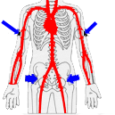
Patient Injuries: Bleeding Treatment
Most external bleeding will stop by:
minimising movement
elevating if possible
applying direct pressure and/or
applying pressure dressings
If bleeding does not stop:
apply firm pressure to a pressure point
pressure points
Notes:
movement = bleeding
If limb injury, elevate above the level of the heart
Pressure dressings: improvise using cleanest object e.g. a t-shirt or sheet

Slide 17
Patient Injuries: Impaled Objects
Do not remove any impaled object!
removing objects can cause
more damage
bleeding (object acts like a plug)
pain
to avoid further damage during the transport try to “secure” the object

Slide 18
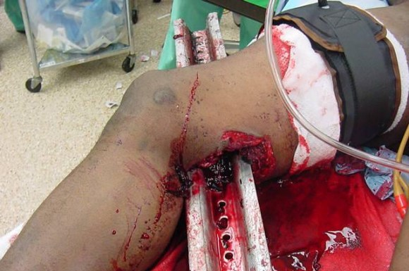
Patient Injuries: Impaled Objects
Warning!
explicit picture

Slide 19

?
вопросов
问题
La question
Fragen
सवालों के जवाब
kysymykset
vragen
perguntas
domande
Questions
الأسئلة
въпроси
質問
Cuestión
sorular
otázky
pertanyaan
küsimused
spørgsmål

