Slide 1

First Responder 2.0
Community Responder Training
Session 16
Session 16
Presentation Title:
Presentation Title:
Basic First Aid
Presenter/Instructor:
Presenter/Instructor:
<Name>
Coordination Saves Lives
Coordination Saves Lives

Slide 2
Basic First Aid
Community Responder Training
Patient assessment
First aid activities
Coordination Saves Lives

Slide 3
Basic Medical Rescue
do no harm
attend a formal First Aid Course (this is no first aid course!)
community responders cannot replace professional help
Always ask if professional help is available and how long it will take them to arrive.
The session’s aim is to provide basic knowledge on how to handle a situation until help arrives.

Slide 4
Patient Assessment
The steps:
initial patient approach
perform a primary survey
identify and control catastrophic bleeding
open airways
place a patient in the recovery position
assess breathing
if possible: First Aid and transport
look for professional medical help

Slide 5
Initial Approach to Patients – the three H’s
Hazards?
Ensure it’s safe to approach patient
Hello?
Check patient responsiveness and do first aid
Help!
Look for professional help
This is for non-medical Community Responders!

Slide 6
Approach to Patient: Responsiveness
“Hello!” observe patient: Are they awake? Do they breath spontaneously? Is there spontaneous movement?
“Hello, this is the rescue, what happened?”
if patient answers clearly:  airways are okay  breathing is okay  circulation is okay
if patient does not: immediately start primary survey to find out why!

Slide 7
Primary Survey
catastrophic bleeding
align spine & airways
breathing
circulation

Slide 8
Primary Survey: Catastrophic Bleeding
Characteristics of arterial bleeding
pulsates
a lot of blood
bright red blood
difficult to stop

Slide 9
Primary Survey: Catastrophic Bleeding
Controlling Catastrophic Bleeding
apply direct pressure by using clothes
use pressure points
elevate if possible (e.g. when on a limb)
do not remove original clothing

Slide 10
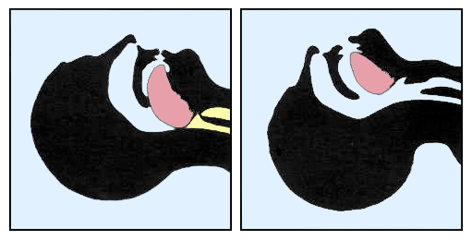
Primary Survey: Align Spine and Airway

Slide 11
Primary Survey: Align Spine and Airway
Align C-Spine
always suspected patients of having spinal injury until proven otherwise
excessive movement could worsen injury
gently move the patient’s head and neck, get it into a neutral position
if patient is unable to do so themselves: maintain support of the patient’s neck in a neutral position
avoid unnecessary movement!

Slide 12
Primary Survey: Align Spine and Airway
Airway
without an open airway, the patient will die
open the airway if it is blocked
most common cause for blocked airway: tongue

Slide 13
Primary Survey: Breathing
Assess
Look
Listen
Feel
If the patient is not breathing
make sure airways are open
If they are still not breathing after opening airways: move to the next patient!

Slide 14
Primary Survey: Circulation
Blood Flow
if there is no pulse, the patient is clinically dead
but it can be difficult to detect a pulse, even for medical professionals
Bleeding
types of bleeding: arterial, venous, capillary
stop serious bleeding immediately

Slide 15

?
вопросов
问题
La question
Fragen
सवालों के जवाब
kysymykset
vragen
perguntas
domande
Questions
الأسئلة
въпроси
質問
Cuestión
sorular
otázky
pertanyaan
küsimused
spørgsmål

