Slide 1

First Responder 2.0
Community Responder Training
Session13
Session 13
Presentation Title:
Presentation Title:
Shoring
Presenter/Instructor:
Presenter/Instructor:
<Name>
Coordination Saves Lives
Coordination Saves Lives

Slide 2
Shoring
Community Responder Training
  Basic shoring for
  doors and windows
Coordination Saves Lives

Slide 3
What are shorings good for?
After an earthquake the building structure is unstable. Aftershocks can cause additional damage to the structure, even the collapse of the building.
Professional rescue teams have many options to shore a building while working inside. But shorings are only effective if they are build exactly according to their function.
This makes the use of shorings difficult.

Slide 4
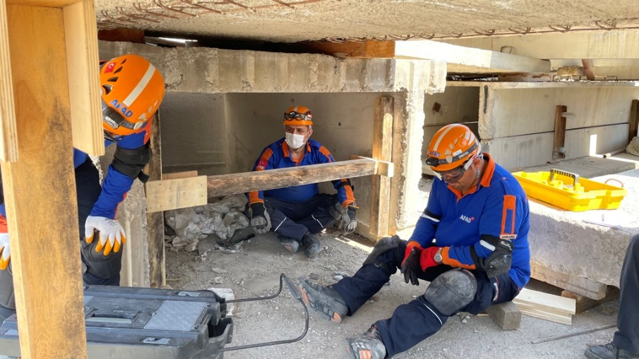
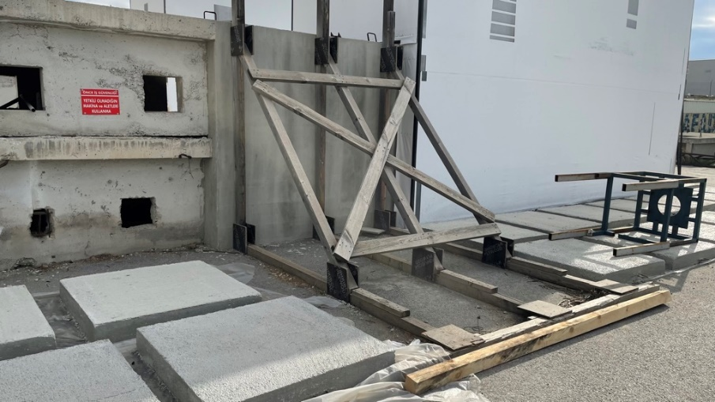
How do shorings look like?
Sidewall-Shoring Buildingwall-Shoring

Slide 5

Principle No. 1:
A shoring takes the load, meaning it gives stability by supporting the structure via the complete load taking in an aftershock

Slide 6
Principle No. 2:
The shoring transports the taken load in its structure without damaging the structure itself

Slide 7
Principle No. 3:
A shoring gives the load away safely without any damage to the shoring structure

Slide 8
Principle No. 4
For a safe load transmission a shoring must be build correctly and have full contact with the building structure.
If there is no full contact, the structure won’t take the load correctly and its transmission does not work. The shoring will start moving in an aftershock.
The shoring will collapse because the force is too strong which leads to the collapse of the building structure.

Slide 9
Shoring needs time!
For example:
3 pieces of timber
2 wedges
2 blinds
What do you think, how long does it take?
Notes:
Show the components on the screen while explaining
Ask 2 or 3 participants how much time this might need?
The answer is: minimum 30 minutes

Slide 10
Shoring needs time!
A shoring stabilizes the building and gives safety for the rescue workers. But it takes much time to build!
Why? Because safety first!
Rescuers spend as little time in the danger zone as possible. So the preparation of the shoring has to be done in the safe zone!

Slide 11
Shoring for Community Responders:
For Community Responders three simple shorings make sense:
overhead shoring (to stabilise a ceiling)
door shoring (to have save entry/exit)
window shoring
In our practical session we will learn how to build these simple shoring that can improve safety for rescuers and victims.

Slide 12

?
вопросов
问题
La question
Fragen
सवालों के जवाब
kysymykset
vragen
perguntas
domande
Questions
الأسئلة
въпроси
質問
Cuestión
sorular
otázky
pertanyaan
küsimused
spørgsmål

