Slide 1

First Responder 2.0
Community Responder Training
Session11
Session 11
Presentation Title:
Presentation Title:
Breaking/Cutting
Presenter/Instructor:
Presenter/Instructor:
<Name>
Coordination Saves Lives
Coordination Saves Lives

Slide 2
Breaking / Cutting
Community Responder Training
  How to break through debris
  Effect on the debris
  Working in confined space
Coordination Saves Lives

Slide 3
Cutting and Breaking Operations
Avoid
move around, under or over the debris
if unstable, keep everyone at a safe distance
Move
if you can’t avoid it, move the debris
use gravity and the terrain to assist
Cut / Break
only if you cannot safely avoid / move the debris
measure and assemble props / shores in a safe place
secure the debris as you lift
use tools to develop the line of weakness until material breaks

Slide 4
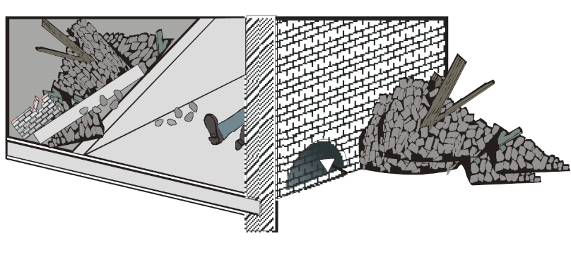
Safety Considerations
breach on an entry point where the work will go quick, without big efforts.
enter with a stretcher
make sure that the breaching work could be done at a brick row deeper if needed
be careful when loosing the first bricks
avoid parts from falling inside the opening (could be a risk for the victim)

Slide 5
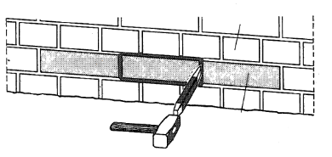
The Breaching Process
Always start with a stretcher course and with the middle brick of that stretcher course. The stretcher course are the lengthways bricks.
header course
stretcher course

Slide 6
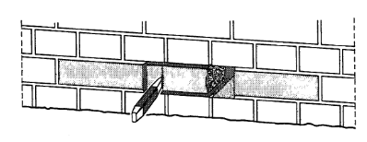
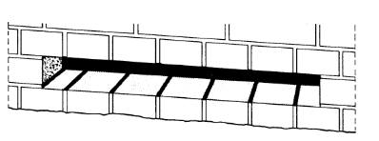
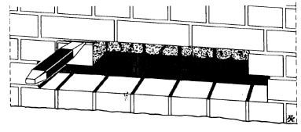
The Breaching Process
Continue with the other bricks in that row.
When completed start at the row above. Go on till the diameter is reached.
diameter

Slide 7
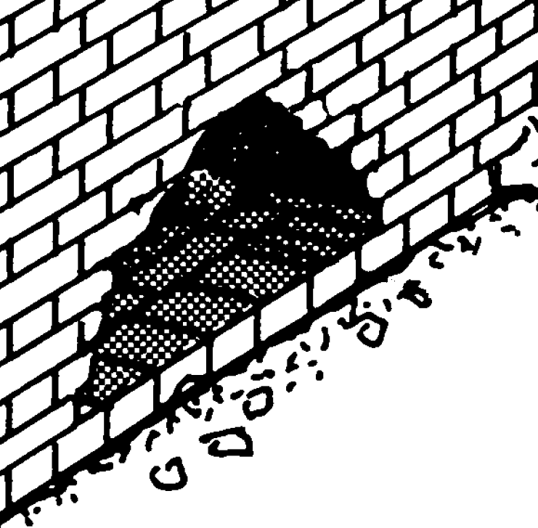
The Breaching Process
Result: The hole should always be shaped like a „roof“.
most stable shape

Slide 8
Safety First!
While working in the debris, void, building or wall:
avoid
secure the rescuer with a rope
never use open fire for illumination
don‘t do the hole in a load bearing wall
check the wall for fractures, or external load
(debris, columns etc.)

Slide 9
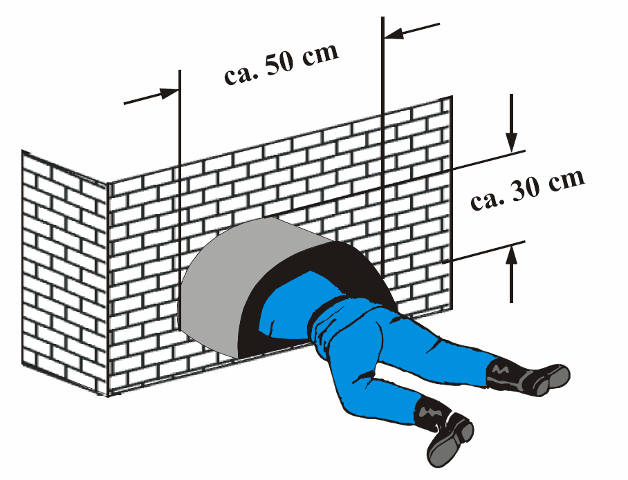
Entering the Building / Void
Entry of the rescuer:
The minimum size for the rescue hole is
30 cm (hight)
50 cm (width)
Be aware:
This measurement is valid for a small person without fear of narrow spaces!

Slide 10
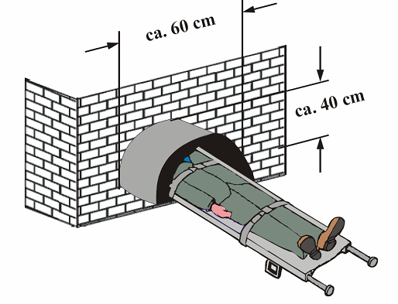
Entering the Building / Void
Using a stretcher
If the victim is injured and needs a stretcher for transportation, the minimum size of the rescue hole is:
40 cm (hight)
60 cm (width)
Notes:
Use a folding rule to demonstrate how small the dimensions are

Slide 11
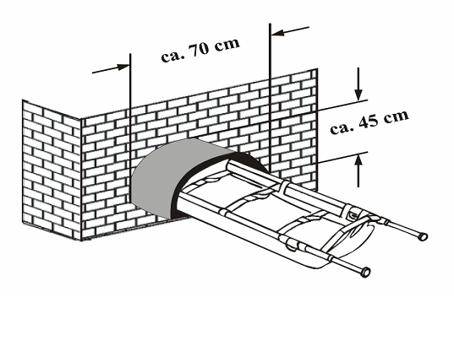
Entering the Building / Void
Bigger victim / tool:
For special rescue tools or larger victims the rescue hole must be: 45 cm (hight)
70 cm (width)
Careful:
Those are minimum dimension!

Slide 12

?
вопросов
问题
La question
Fragen
सवालों के जवाब
kysymykset
vragen
perguntas
domande
Questions
الأسئلة
въпроси
質問
Cuestión
sorular
otázky
pertanyaan
küsimused
spørgsmål

