Slide 1

Community Responder Training
Session 01
Presentation Title:
Disaster Environment
Presenter/Instructor:
<Name>
Coordination Saves Lives

Slide 2
Disaster Environment
Community Responder Training
Post-earthquake situation
Where to find victims
Coordination Saves Lives

Slide 3
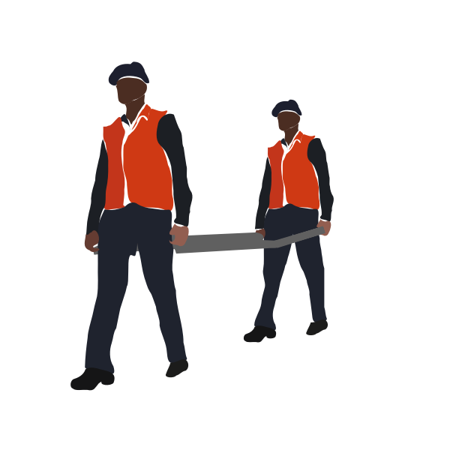
Post-Earthquake Situation:
Buildings are damaged or collapsed
Technical infrastructure is not working
Roads and bridges damaged
Risk of aftershocks
Unsafe environment, full of hazards
People are in need of help
Rescue needs to start as soon as possible!

Slide 4
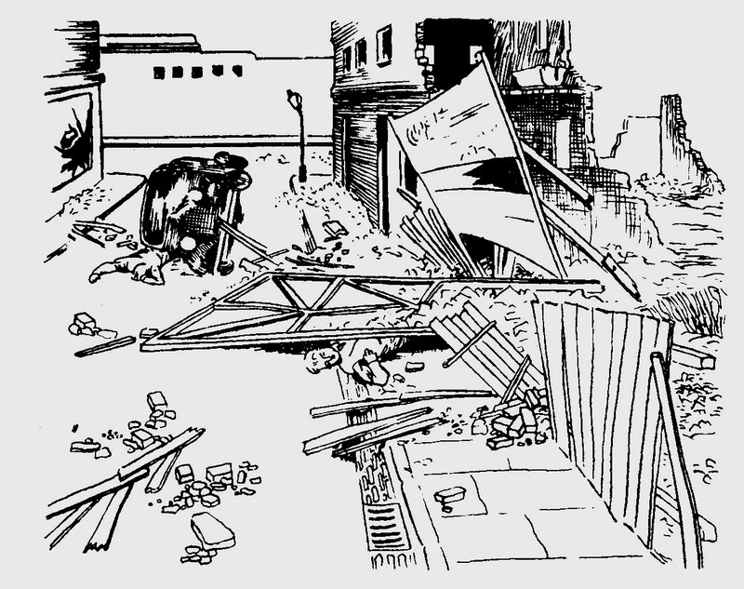
50% of the victims are found at or near the surface

Slide 5
50% of the victims are found at or near the surface

Slide 6
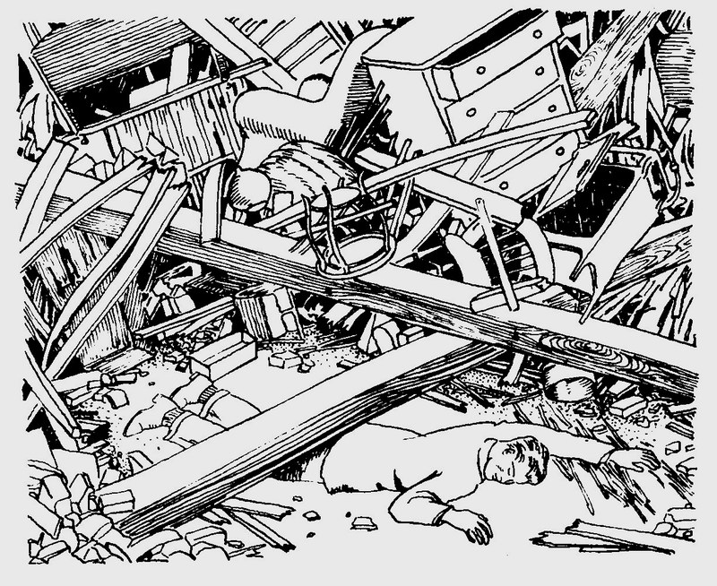
35% of the victims are lightly trapped

Slide 7
35% of the victims are lightly trapped

Slide 8
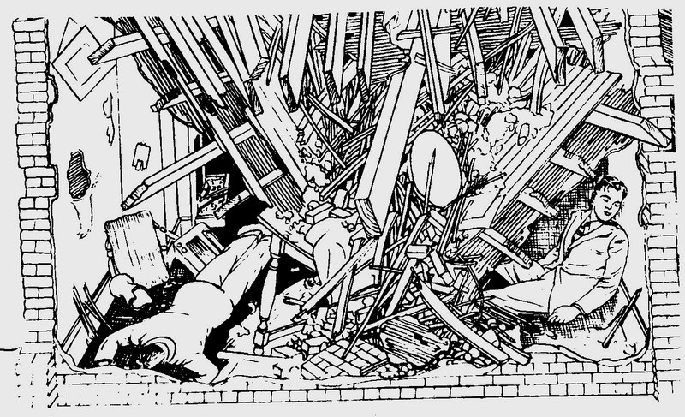
15% of the victims are trapped in void spaces
Notes:
Like building structures

Slide 9
15% of the victims are trapped in void spaces
Notes:
Like building structures

Slide 10



Community Responder Potential
found at or near surface
lightly trapped
trapped in void spaces
up to 85 % of possible victims can be helped by Community Responders!

Slide 11

Brainstorming:
Why is it so difficult to rescue people who are trapped in voids within buildings?
... 5 minutes …
Notes:
Discussion not longer than 5 minutes!
Expected results: Risks due to debris/collapse, special tools needed, special training needed, long working time: risk of aftershock

Slide 12
Building Constructions:
Mud brick, un-reinforced masonry
Light timber or bamboo frame
Reinforced masonry
Concrete framed
Monolithic concrete, precast sections
Each construction type often collapses in predicted ways, leaving patterns of hazards…
…and voids where people can be rescued!
Notes:
Focus for non-professional First Responders are the first three constructions, the last two are mainly for professional FR due to lack of tools

Slide 13
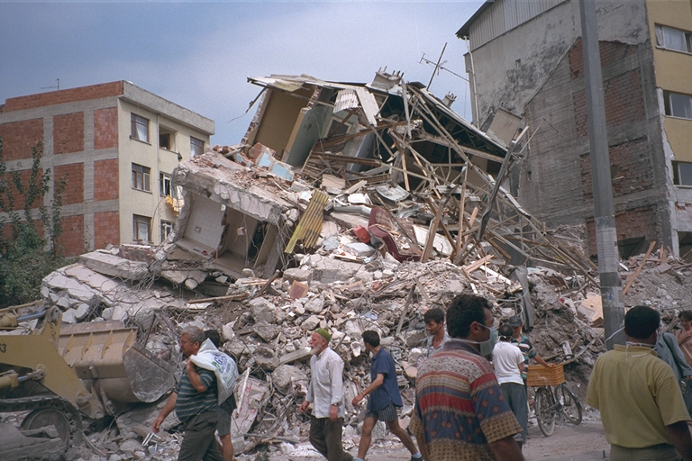
Typical Collapse Patterns:
Lean-to
Cantilever
Pancake
V-type
A-frame

Slide 14
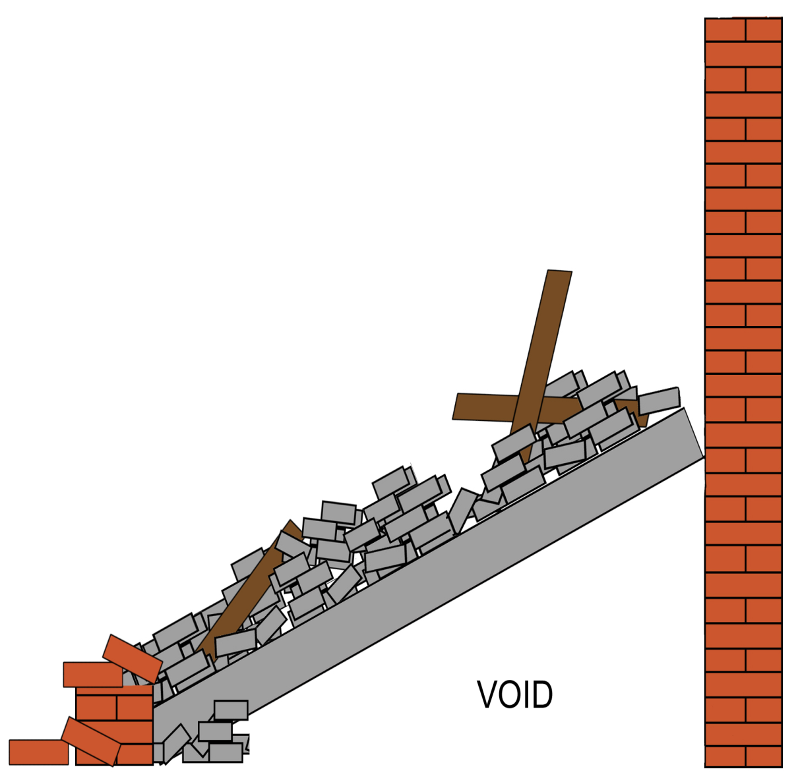
Lean-to or supported:
Floor/wall connection at one end fails
Debris supported by the remaining wall
Large but unstable voids
Victims in voids

Slide 15
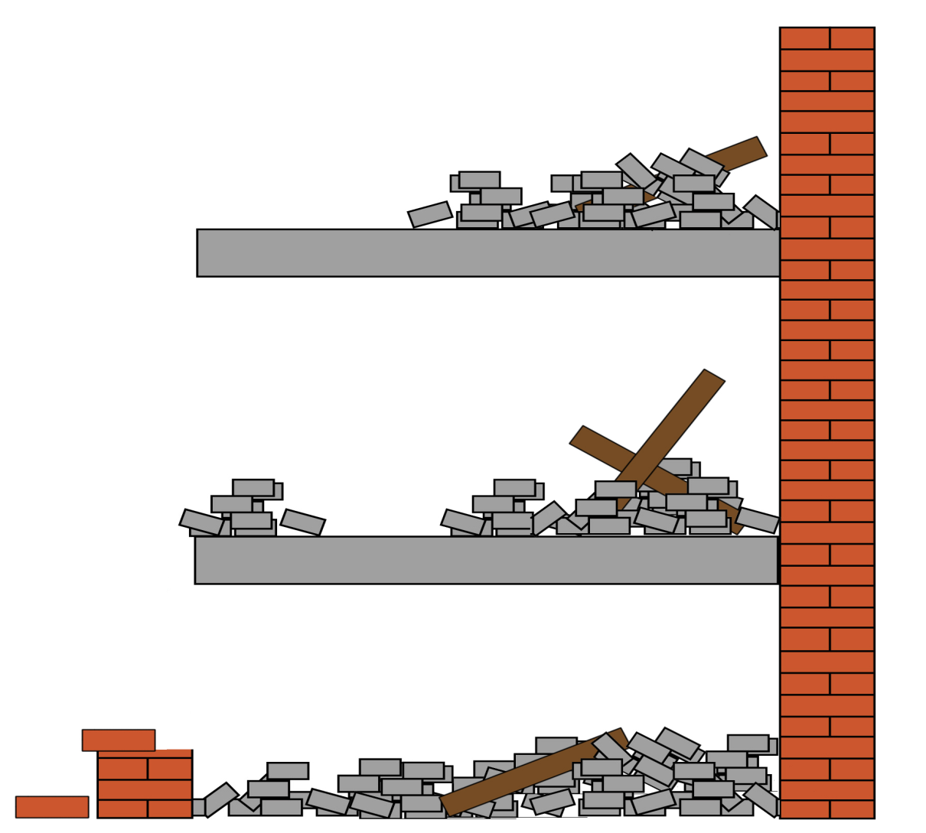
Cantilever or hanging:
Floor is supported at one end only
Victims not able to get down
Debris is very unstable
Strongest part next to the remaining wall

Slide 16
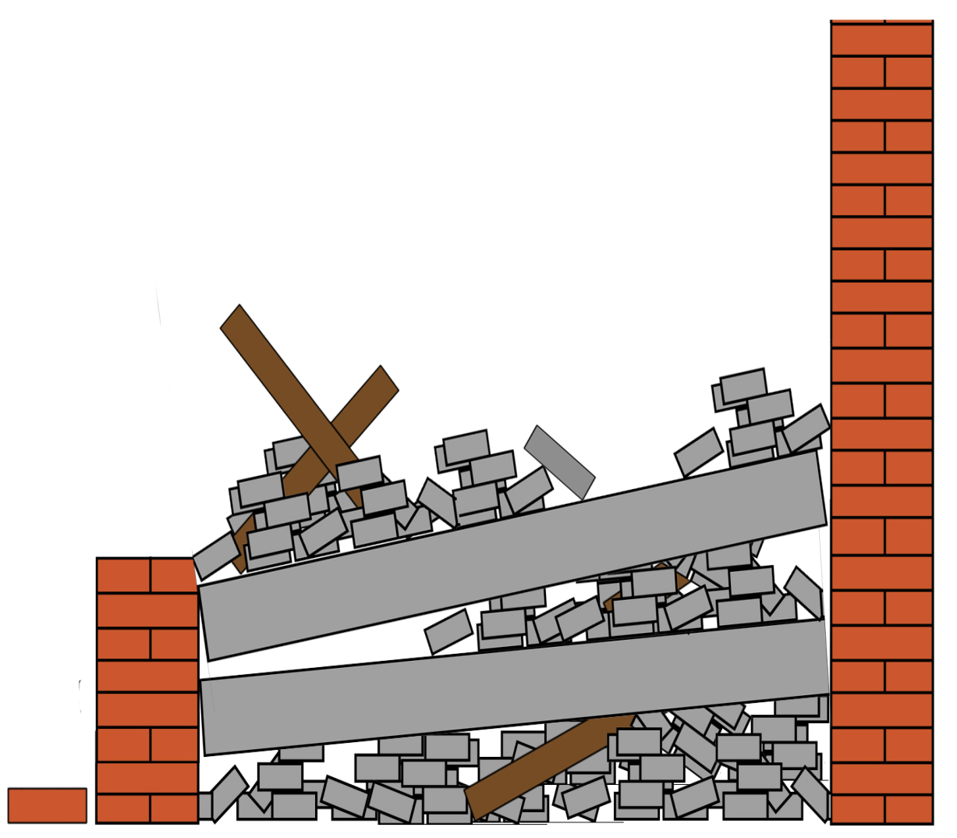
Pancake or total collapse:
Floor/wall connections fail at both ends
Debris impact onto floors below causing further collapse
Fairly stable
No or few voids
Not very survivable
Notes:
Make stement that this is a job for highly specialized USAR Teams

Slide 17
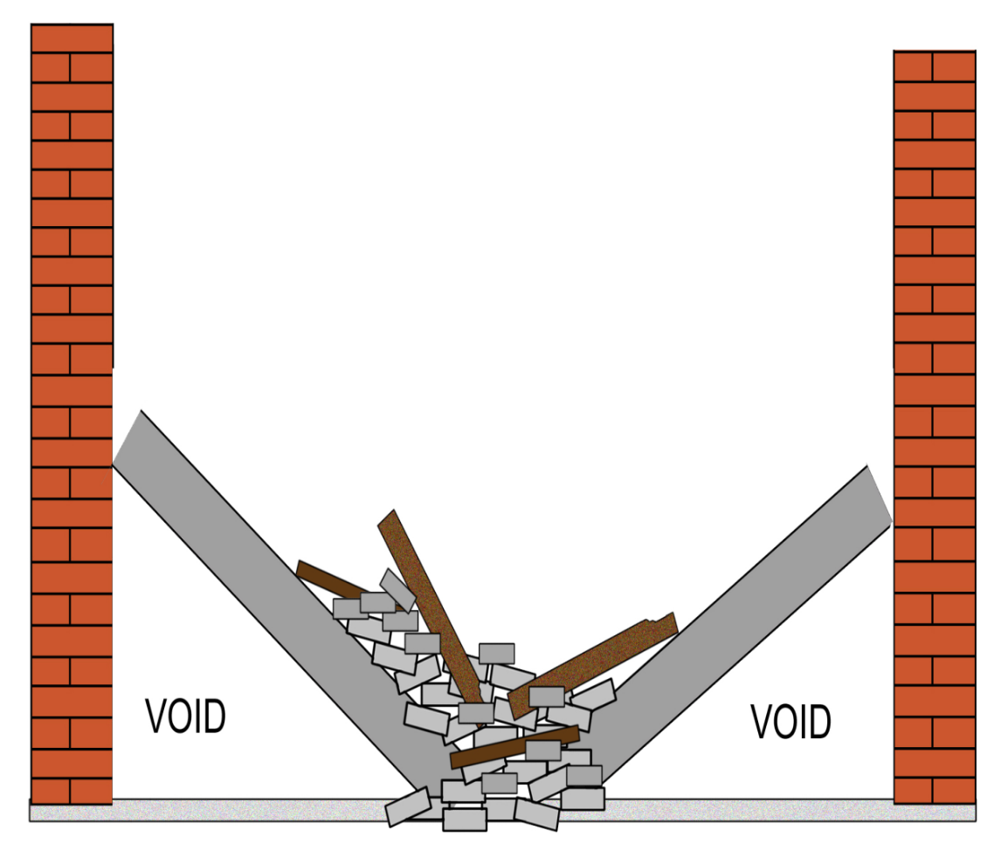
V-type collapse:
Floor fails in the center
Fairly stable
Victims found in small voids below the floor and the debris on top of floor

Slide 18
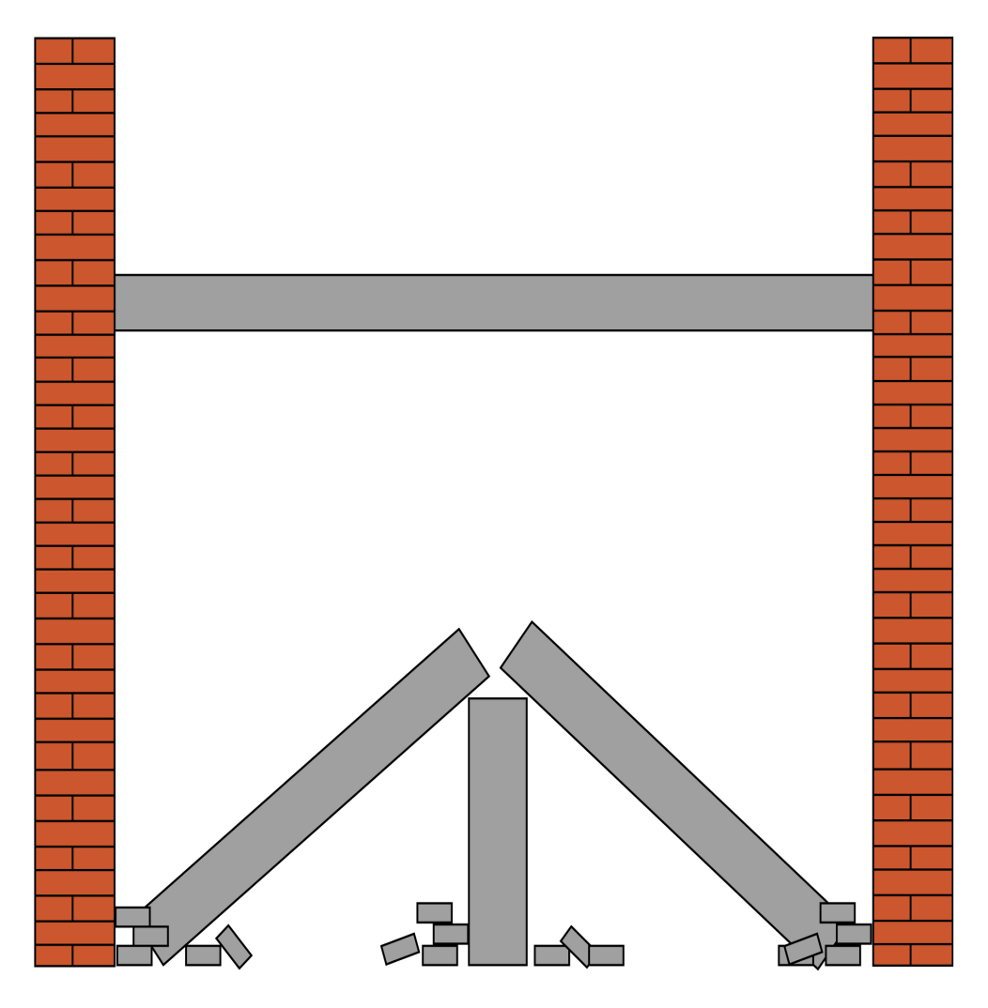
A-frame or tent collapse:
Floor/wall connections fail at both ends
Interior load bearing wall or girder remains intact
Fairly stable
Victims in small voids below

Slide 19

?
вопросов
问题
La question
Fragen
सवालों के जवाब
kysymykset
vragen
perguntas
domande
Questions
الأسئلة
въпроси
質問
Cuestión
sorular
otázky
pertanyaan
küsimused
spørgsmål

