Slide 1

Community Responder Training
ToT – Session 3
Presentation Title:
Localization as the key element for the participants
Presenter/Instructor:
<Name>
Coordination Saves Lives

Slide 2
Localization as Key Element
Community Responder Training
Using the course as a tool box
Customizing the content for the participants
Coordination Saves Lives

Slide 3
Brainstorming: How to localize the course?
Open discussion 40 minutes!
This will be your own customized Power Point slide!

Slide 4
Be open for changes!
But know about best practices:
have a clear lesson structure
avoid information overkill
be clear in language and examples
don’t jump back and forth
don’t alternate the slides to often
use fitting pictures to visualize the topic

Slide 5
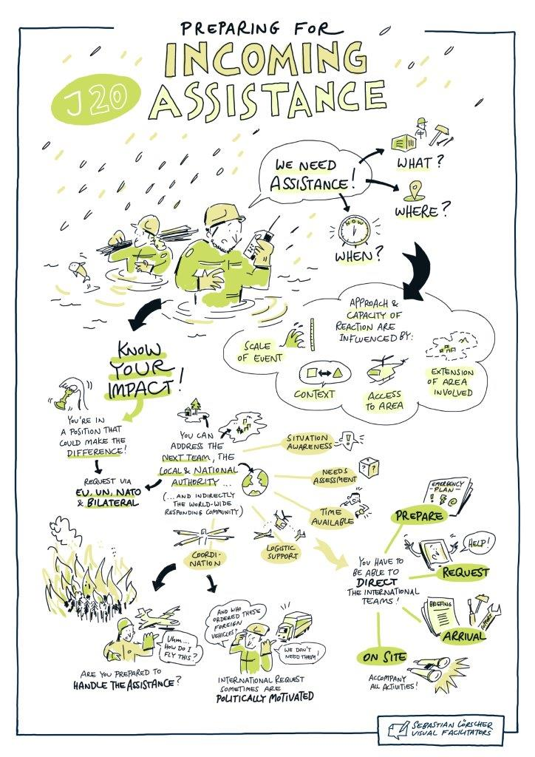
Be open for changes!
Visualisation through doodles

Slide 6

?
вопросов
问题
La question
Fragen
सवालों के जवाब
kysymykset
vragen
perguntas
domande
Questions
الأسئلة
въпроси
質問
Cuestión
sorular
otázky
pertanyaan
küsimused
spørgsmål

