Slide 1

Community Responder Training
ToT – Session 2
Presentation Title:
How to get the best training result
Presenter/Instructor:
<Name>
Coordination Saves Lives

Slide 2
How to get the best training result
Community Responder Training
Using Group Work
The “Hands-On” Approach
Mixing Theory and Practical Elements
Coordination Saves Lives

Slide 3
Session Goals
knowing the difference between child orientated learning and adult education
understanding the challenges in adult learning
recognizing the potential of the “hands-on” approach

Slide 4
Experimental Learning
A learning theory for adult education that fits perfect for the better understanding of the topics.
Active participation is the key! Participants should reflect upon what they are doing.
Four key elements are:
Active involvement of the participants
Analyzing the experience
Evaluation of practical sessions
Use of knowledge gained from the experience

Slide 5
Experimental Learning: Participant Engagement
involve participants in planning their learning
Learners deciding on their learning goals will be more motivated!
encourage critical reflection
Ask for feedback, introduce self-evaluation to track own learning progress.
create a story
Help to overcome challenges related to the new topic.

Slide 6

Experimental Learning: Using Group Work
not more than two groups, if possible
more will be difficult for the trainer to follow
participants can discuss their experiences and knowledge
participants understand the topic better
visualize findings (e.g. on a flipchart)
helps to remember

Slide 7

Experimental Learning: The Hands-On Approach
learning by doing
helps to memorize new knowledge
learners are in the center of the learning process
learning through active process of doing and reflection

Slide 8
Group Work:
You have 20 minutes for discussion and 5 minutes per group to present the results.
Please discuss:
What could be challenges in adult education that make learning difficult?

Slide 9
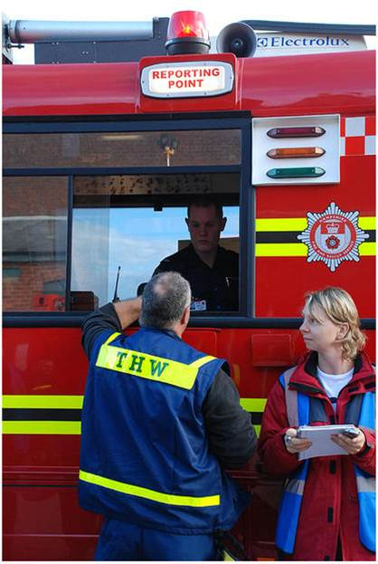
Learning Challenges
difficulty to stay focussed
not seeing the big picture (accepting the need for being trained)
fear of not knowing something essential, being criticised (“imposter syndrome”)
Notes:
What prevents adult learners from trying new things, growing their skills or obtaining new knowledge?

Slide 10

?
вопросов
问题
La question
Fragen
सवालों के जवाब
kysymykset
vragen
perguntas
domande
Questions
الأسئلة
въпроси
質問
Cuestión
sorular
otázky
pertanyaan
küsimused
spørgsmål

