Slide 1

Community Responder Training
ToT – Session 1
Presentation Title:
Basics of Adult Education
Presenter/Instructor:
<Name>
Coordination Saves Lives

Slide 2
Basics of Adult Education
CommunityResponder Training
Introduction to basic elements of methodology and didactics
How to prepare as master trainer
How to train trainers
Coordination Saves Lives

Slide 3
Why adult education?
Adults learn differently than children:
they already have knowledge and life experience
adults understand why they are learning
it is better to let adults work things out themselves
a teacher can be a colleague or a trainer
Challenges for the trainers are:
their own motives
emotional baggage
cognitive characteristics
…

Slide 4
Didactics
Didactics is the art of teaching.
how to structure a course
how to organise and plan the course content

Slide 5
Methodology
Methodology is the way of teaching.
how to implement new knowledge
how to make participants remember

Slide 6
Groupwork
Split up in two groups. You have 20 minutes for discussion and 5 minutes per group to present the results.
Please discuss:
What are examples for didactics (art of teaching)?
What are examples for methodology (way of teaching)?
Does culture matter for training?

Slide 7
What About Culture?
… old and experienced?
… a man?
A trainer must be …
… a professional?
… and if it’s free it can’t be good!

Slide 8
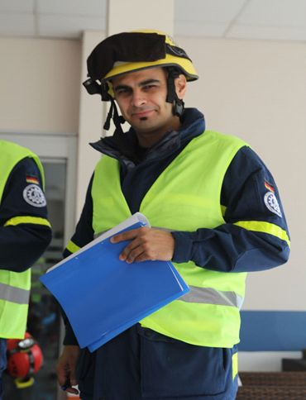
What Makes a Good Trainer?
an active teaching style
the ability to motivate
the use of pictures
easy language
… but most of all, it is
yourself!

Slide 9
A Good Trainer: Soft Skills
ability to explain difficult things in a simple way
appropriate usage of their knowledge
Remember: some people haven’t had much education! Get a feeling for your participants’ level.
The next sessions give advise for further improvements.

Slide 10
A Good Training: Preparation
master trainers must know the courses’ topics and check the content for being suitable
if needed, they adjust the content to the participants’ level (theory and practical content!)
master trainers should come from Civil Protection, Urban Search and Rescue or from the ambulance services (for medical sessions)

Slide 11
A Good Trainer: Summary
knowledge of the topic (must be up to date)
knowledge about teaching methods
structured lessons (no inconsistencies)
ability to motivate the participants
ability to self-reflect (how could I do better?)
adaptation of lessons for the targeted group

Slide 12

?
вопросов
问题
La question
Fragen
सवालों के जवाब
kysymykset
vragen
perguntas
domande
Questions
الأسئلة
въпроси
質問
Cuestión
sorular
otázky
pertanyaan
küsimused
spørgsmål

