Slide 1

Community Responder Training
Training of Trainers
Presentation Title:
Course Overview
Presenter/Instructor:
<Name>
Coordination Saves Lives

Slide 2
Course Overview
CommunityResponder Training
Learnings targets
Course topics
Course variations
Coordination Saves Lives

Slide 3
Why are we here?
earthquakes are one of the deadliest natural hazards
more than 50 earthquakes every day worldwide
biggest cause of fatalities: building collapse (responsible for 75% of all deaths)
85-95% live rescues from collapsed buildings the first 24-48 hours after the earthquake
after 120 hours: unlikely to survive

Slide 4
Who are First Responders?
locally organised rescue capability
professional rescuers (emergency services, civil defense, military, police)
AND
non-professionals (volunteers, neighbours, friends – you!)
⇨ we call them “community responders”

Slide 5
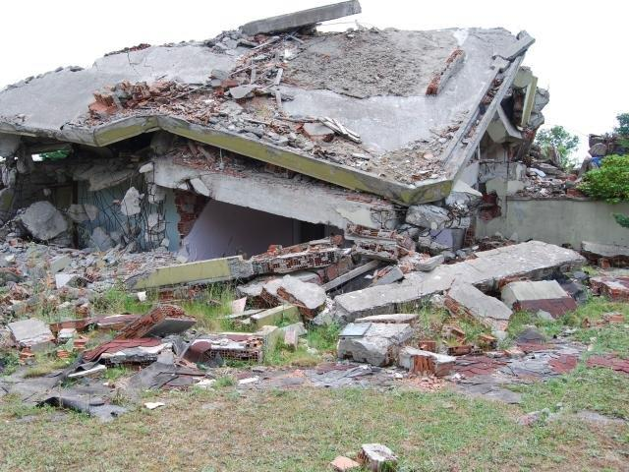
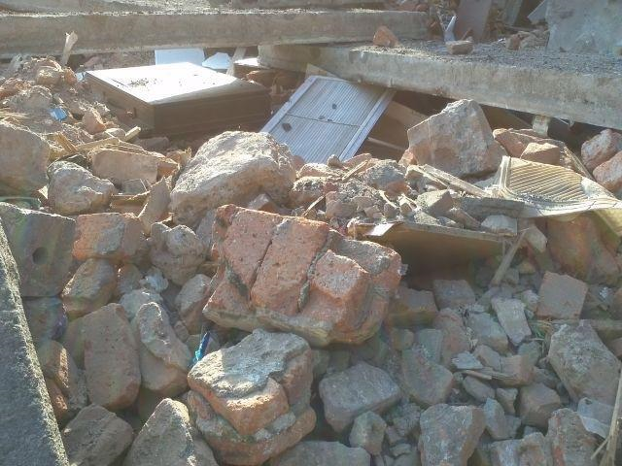
Community Responders are important!
They…
rescue right after an earthquake
give information to others (e.g. professional teams)
start the first assessment

Slide 6
First Responders Training (FRT) & Community Responders Training (CRT)
The FRT was for professional first responders. Since 2008, it was implemented in many countries.
The CRT is completely re-designed for non-professional first responders.
It is …
in simple language
easy to understand by everyone
not too technical
simple but effective small exercises

Slide 7
Main Goals:
Participants …
know basic rescue methodology
can do basic search and rescue work
can provide initial first aid
can manage a rescue team
know how to coordinate rescue works

Slide 8
Standardized And Flexible
Training of Trainers Course: 4 days
CRT Course: 3 days
sessions can be shortened or expanded (toolbox)
session can be done virtually or in-person
sessions can be used as re-fresher, too

Slide 9
Localisation
Participants take more from the course when it fits their local situation.
The course is designed as tool box, sessions can be taken out if not needed.
All pictures are place holders, they can be changed to local examples.
No need for a training centre! Exercise can be adopted to any place.
Notes:
Explanation of tool box: course is adaptable, trainers can choose sessions/contents as they see fitting the audience - like the tools out of a tool box.

Slide 10

?
вопросов
问题
La question
Fragen
सवालों के जवाब
kysymykset
vragen
perguntas
domande
Questions
الأسئلة
въпроси
質問
Cuestión
sorular
otázky
pertanyaan
küsimused
spørgsmål

